Slide 1
PERTH CITY & TOWNS
SUPPORTING YOUR TOURISM BUSINESS

Slide 2


Our Channels
Perthcityandtowns.co.uk website
An average of 24K page views per month rising to 65K over key periods
Facebook @perthcityandtowns 33K Followers
Twitter / X @perthcitycentre 11.5K Followers
Mailchimp
23K recipients
Instagram
6.8K Followers @perthcityandtowns
YouTube
Over 40 hours of watch time in 2023

Slide 3
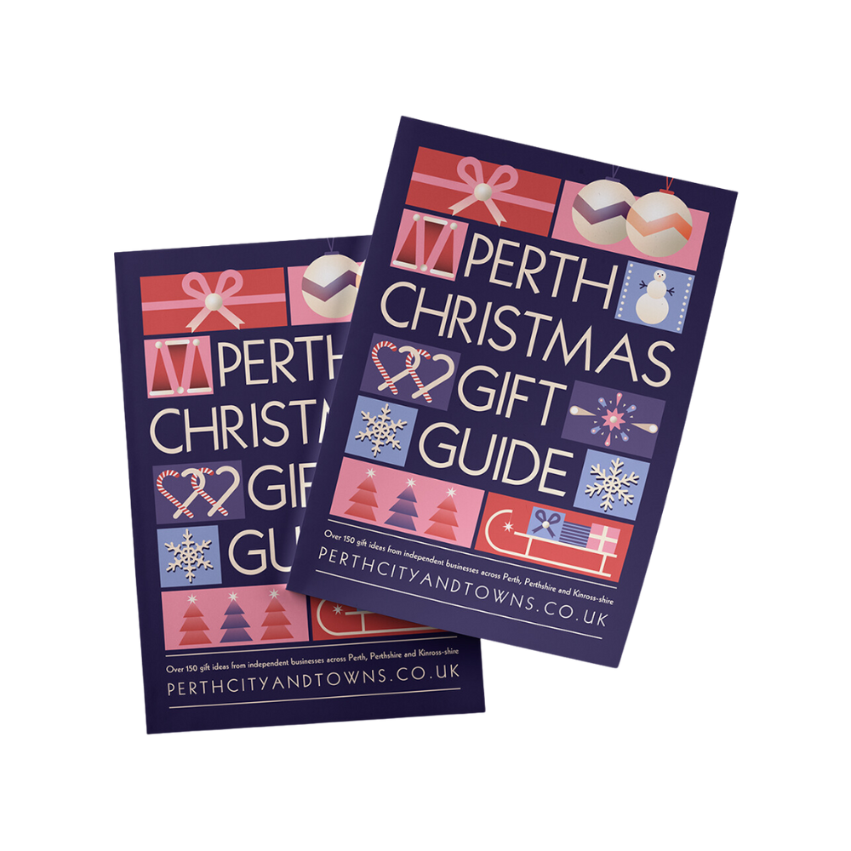
Ongoing Business Opportunities
Join the Business Directory
Create a login, a listing and take full control of your entry, updating any time you wish. Already Listed? Check and update for 2024 promotions coming soon!
List your Event
Simply create your Facebook event, add Perth City & Towns as a co-host and it will appear on our Facebook page and in our website event section. We may also list it in our newsletters to our 23K strong list.
CHRISTMAS
IS
MADE
Keep Up To Date
Join the mailing list for the Business-To- Business newsletter from Emily Queen.
www.perthcityandtowns.co.uk/business-opportunities
FREE CHRISTMAS
GIFT
GUIDE
Featuring over 100 gift ideas from the fantastic independent shops of Perth, City and Towns

Slide 4
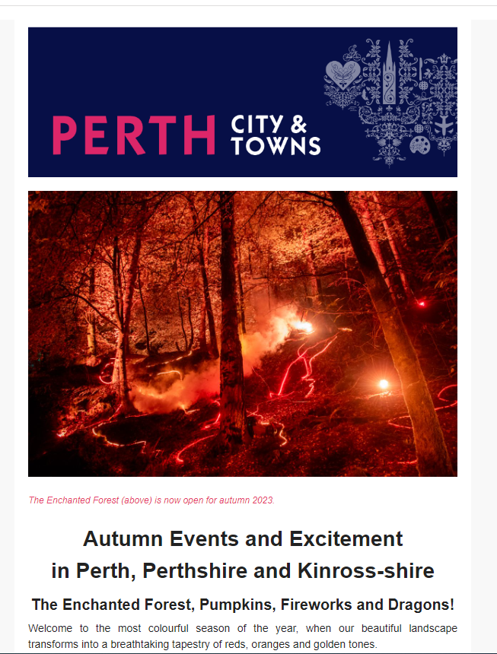
Marketing Month To Month
Social Media Channels
Run by the PKC Comms Team, the social channels enjoy daily content updates and a strong following. Share your Facebook event with us and enjoy a share of the success.
Monthly Newsletter
Sent to our 20K+ mailing list every month – with extras at peak times – our editorial style newsletter boasts a 35% open rate. Used to promote events, meet the indies, and Be Inspired content.
CHRISTMAS
IS
MADE
New Content
A content plan for each month is formed to ensure the ongoing success of the website in terms of SEO and reach.
Events & Festivals Blog
Updated weekly, this fantastic blog has had 23K page views in the past 6 months. A popular go to for locals and SEO champion in traffic driving!
FREE CHRISTMAS
GIFT
GUIDE
Featuring over 100 gift ideas from the fantastic independent shops of Perth, City and Towns

Slide 5
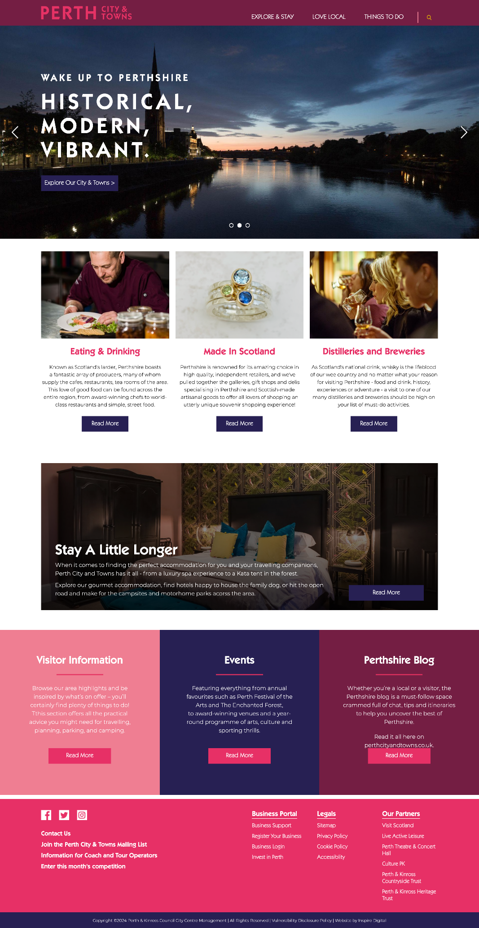
Brand & Website Refresh 2023
Update to Brand
The long-standing Perth City Centre brand was updated to reflect the wider area. All channels now run under Perth City & Towns.
Towns Promotion
A more prominent focus on towns, with a dedicated page for each featuring things to do and businesses to visit.
New Navigation & Content Reorder
A more modern look & feel, with a mobile-first approach to design. The new look website has put the Mega Menu function to great use – with fantastic feedback from businesses and users.
Explore Perthshire Interactive Map
Information such as caravan and camping sites; parking spots; public toilets; ev charge points; water refill stations; walking routes and much more.
CHRISTMAS
IS
MADE
Feature Blocks on Home Page
Interchangeable blocks for highlighting seasonal promotions or rotating interest in shoulder months.
Business To Business ‘Quick Find’
A footer link just for businesses. Find the best ways for your business to get involved with PC&T.
FREE CHRISTMAS
GIFT
GUIDE
Featuring over 100 gift ideas from the fantastic independent shops of Perth, City and Towns
www.perthcityandtowns.co.uk

Slide 6
Be Inspired Perthshire Blogs
Accommodation
Quirky Accommodation
Spa Breaks & Hot Tub Hideaways
Campsites & Caravans
Gourmet Accommodation
Pet Friendly Accommodation
Attractions
Historical Attractions
Castles
Gardens & Grounds
Distilleries & Breweries
Shopping
Farm Shops & Delis
Made in Scotland
Perthshire Jewellers
Regular Markets
Also: Meet The Perth Indies
Activities
Golf Clubs
Learn To
Meet The Animals
Free Activities
Eating & Drinking
City Centre Restaurants
Area Wide Restaurants
Afternoon Tea
Soup & Sandwich Stops
Cocktails and Artisan Drinks
Scottish Breakfasts
Outdoor Adventure
Perthshire Adventure
River & Lochs Adventure
Cycling Perthshire
Experience Nature
Munro Bagging
Big Tree Country

Slide 7
Four Media | Creative Content Planning
Our new marketing agency, Four media is a creative communications agency with a global mindset. Appointed in December 2023, they are tasked with assisting us in communicating our story in a meaningful way, elevating our brand and setting us apart from other Scottish destinations. .
This year, they propose that we tap into topical themes in line with our vision and values - particularly those that we can involve local businesses and attractions in.
Dry January
Campaign Ideation – January to March
Immerse yourself in nature’s playground with our curated array of outdoor escapades – from an invigorating hikes along scenic trails to heart-pounding adventure in the rugged terrains.
Unleash your spirit of exploration through thrilling activities like mountain biking, kayaking amidst stunning landscapes, and discovering hidden gems off the beaten path.
Prioritize your health & wellbeing with rejuvenating wellness retreats, serene yoga sessions amidst nature’s serenity, and locally sourced, nutritious culinary experiences that nourish both body and soul.
Veganuary
Valentines Day
Perth Museum Opening Weekend
Easter Sunday
Mental Health Awareness Week
Accessibility Awareness Day
World Tourism Day
World Mental Health Day
Small Business Saturday

Slide 8
Four Media |Campaign Ideation April to June
Experience Easter Magic in Perth City and Towns - join us for a celebration filled with colourful Easter egg hunts, festive parades, and captivating events. Discover the traditions that make this holiday special as our vibrant community comes together to share in the family festivities during the Easter holidays.
Savor the Flavors of Perth, Perthshire and Kinross-shire this April! Indulge your palate in a gastronomic journey showcasing the region's finest culinary delights. Immerse yourself in a tapestry of tastes and aromas with our specially curated Foodie Content. From farm-to-table treat yourself to a feast of local flavours, where every bite tells a story.
Embark on an adventure-filled journey tailor-made for families. Engage in a range of exciting and enriching activities designed for all ages. Dive into the Perth treasure trail, delight in themed events, and join in the fun of family-centric attractions.
Dry January
Veganuary
Valentines Day
Perth Museum Opening Weekend
Easter Sunday
Mental Health Awareness Week
Accessibility Awareness Day
World Tourism Day
World Mental Health Day
Small Business Saturday

Slide 9
Four Media |Campaign Ideation July to September
Embrace the Summer season as Perth welcomes you to a Summer Holiday haven. From the picturesque River Tay offering riverside walks to the lush parks providing a serene escape, indulge in a summer filled with outdoor adventures.
Engage in water sports, explore historic landmarks, or simply relax amidst stunning natural beauty. Let Perth be your idyllic destination for a (hopefully) sun-soaked summer holiday filled with exploration and relaxation.
Experience the Vibrancy of Perth's Summer Events! Immerse yourself in a kaleidoscope of cultural celebrations, music festivals, and art exhibitions that enliven the city during the Summer months. From traditional Highland games celebrating Scottish heritage to music and arts festivals that showcase local talent, Perth's event calendar is packed with excitement.
Uncover the Charms of Perth's Tourism Attractions! Embark on a journey through Perth's rich history and natural wonders. Explore iconic landmarks such as Scone Palace, delve into the city's past at The Black Watch Castle and Museum, or marvel at the beauty of the Perth Concert Hall.
Discover the enchanting beauty of Perthshire's countryside with its rolling hills, tranquil lochs, and scenic trails. Every attraction is a testament to Perth's unique heritage and natural splendour, inviting visitors to immerse themselves in its timeless allure.
Dry January
Veganuary
Valentines Day
Perth Museum Opening Weekend
Easter Sunday
Mental Health Awareness Week
Accessibility Awareness Day
World Tourism Day
World Mental Health Day
Small Business Saturday

Slide 10
Four Media |Campaign Ideation October to December
Celebrate Spooktacular Halloween and Magical Christmas Moments in Perth and Its surroundings!
Prepare for a thrilling Halloween season filled with spooky delights and unearthly adventures throughout October. Join us for haunted tours, eerie storytelling, and festive gatherings that promise chills and thrills for all ages. Embrace the spirit of Halloween with family-friendly events, costume contests, and spooky surprises around every corner.
As the air turns crisp and winter sets in, Perth transforms into a winter wonderland for the Christmas season. Experience the magic of Christmas with enchanting markets, dazzling light displays, and joyful festivities starting from late November.
Immerse yourself in the holiday spirit with carol singing, Santa's grottos, and artisanal crafts at bustling Christmas markets. Enjoy ice skating, festive performances, and heartwarming community events that capture the essence of the season.
Dry January
Veganuary
Valentines Day
Perth Museum Opening Weekend
Easter Sunday
Mental Health Awareness Week
Accessibility Awareness Day
World Tourism Day
World Mental Health Day
Small Business Saturday

Slide 11
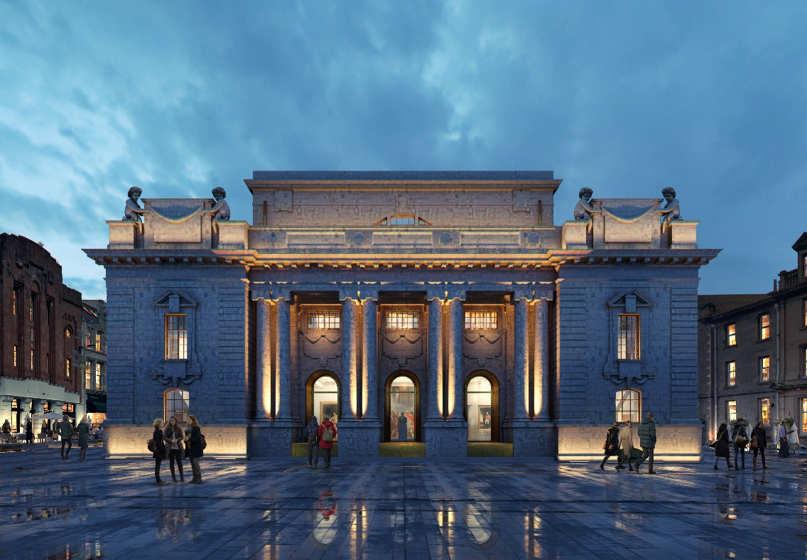

Perth Museum | Opening March 2024
The new Perth Museum will open its doors on Saturday 30 March 2024 after a £27 million redevelopment project. This world-class cultural and heritage attraction will highlight the fascinating objects and stories that put Perth and Kinross at the centre of Scotland’s story.
The Stone of Destiny
At the heart of the Museum will sit the Stone of Destiny, also known as the Stone of Scone, one of Scotland and the UK’s most significant historical objects. Returning to Perthshire for the first time in over 700 years, the Stone will be the centrepiece of the new Museum and will be free for all to view.
Unicorn | The Debut Exhibition | 30 Mar – 22 Sept 2024
Be enchanted by Unicorn, the debut exhibition at the new Perth Museum exploring the story of Scotland’s national animal. Explore the rich significance of this beloved mythical creature from antiquity to the present day, through art, science, social movements, and popular culture.
www.perthmuseum.co.uk

Slide 12
Perth City & Towns B2B Contact
Emily Queen | ERQueen@pkc.gov.uk
www.perthcityandtowns.co.uk/business-opportunities

