Slide 1
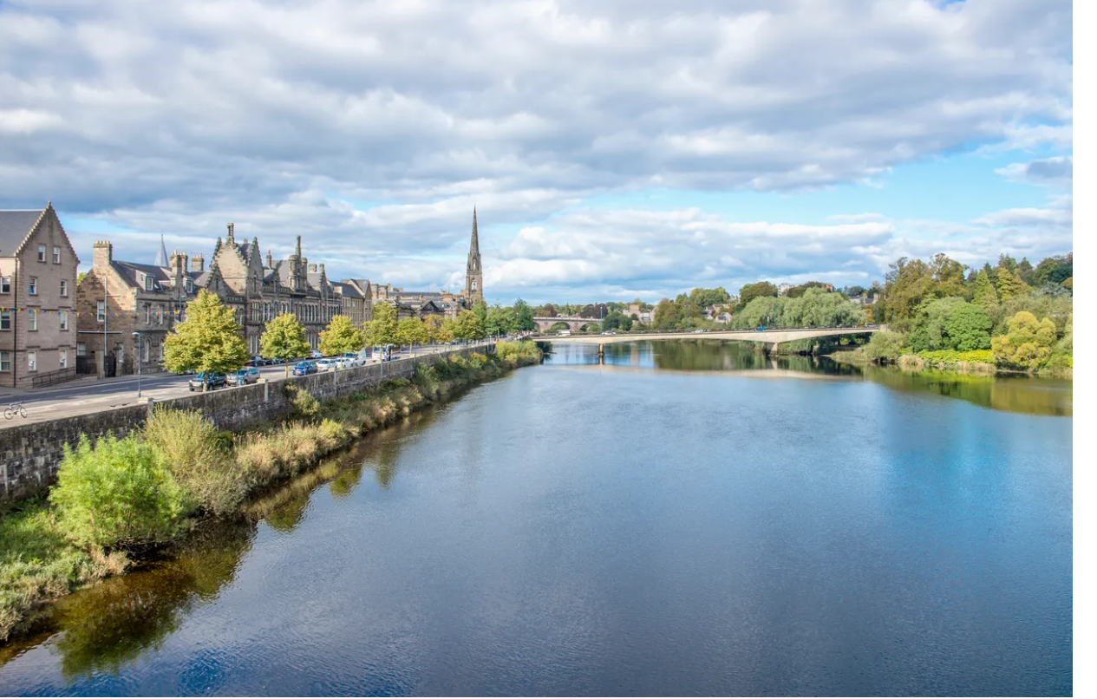
Perth Museum – Industry Webinar
International Market opportunities
Patrick O’Shaughnessy Industry Manager (Development)

Slide 2
Travel Distribution
Content
The International Opportunity
The Customer Journey
Its about Tech
Working with Intermediaries
Offline/Travel Trade distribution

Slide 3
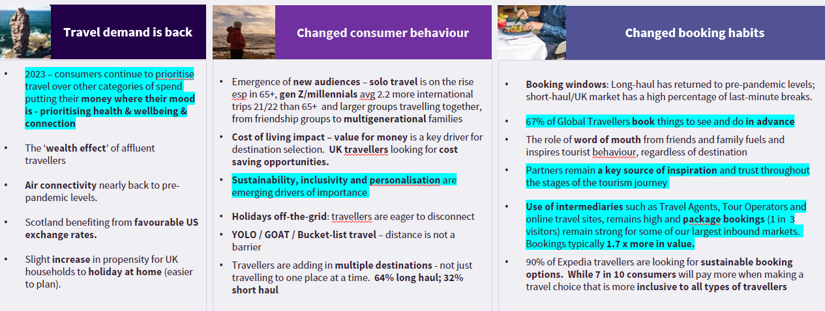
Travel Distribution
Travellers have changed
Notes:
Website/Booking solution
Inbound Tour Operator
Travel agencies/Wholesalers
Destination Management Company(DMC) – Jac travel/Abbey
Online Travel Agent(OTA) – for Experiences Viator(The biggest), Get Your Guide, Expedia(who get their inventory from Viator & GYG) Booking.com(who get their inventory from Viator and Musement), For accommodation – Booking.com, Expedia(are the two biggest) Ctrip for Asia particularly mainland China.
Digital Distribution Channels
Icentres/Hotel Concierges/VisitScotland

Slide 4
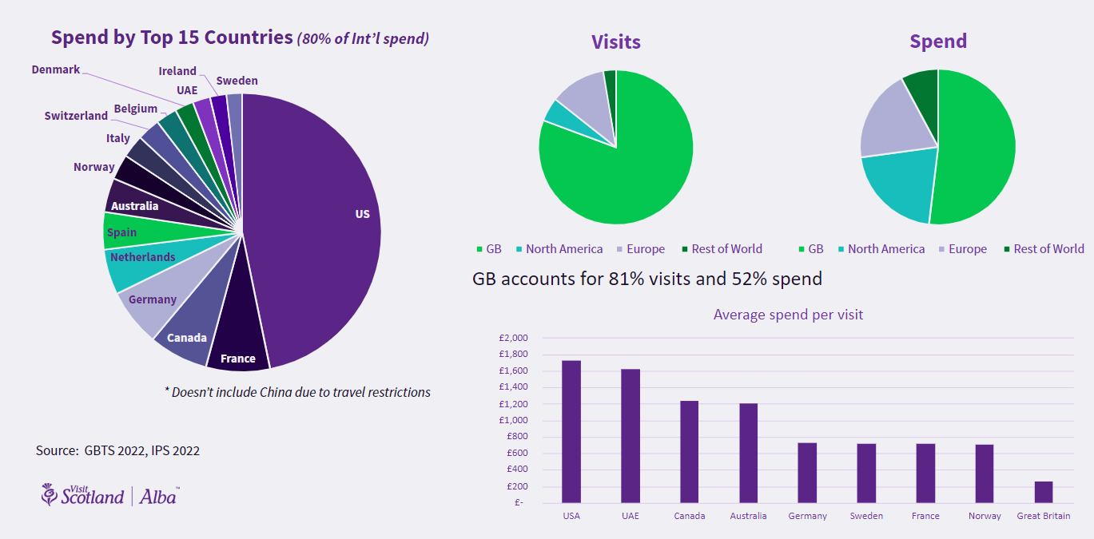
Travel Distribution

Slide 5
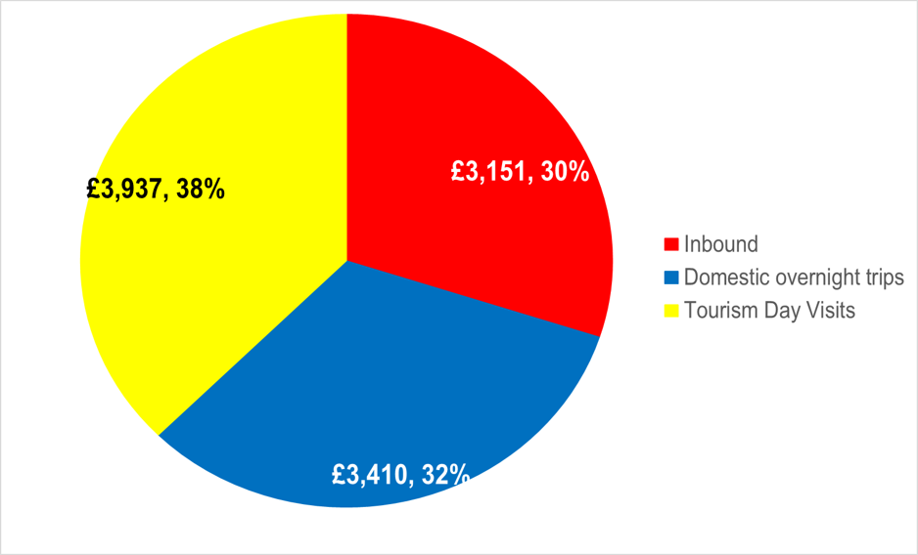
Travel Distribution
Why build international demand
International visitors critical to business recovery – to build back tourism sustainably​
On average US visitors spend 4x more than a UK visitor; EU visitors spend twice as much
Promoting internationally to a range of key markets will mitigate against fluctuating economic challenges – reducing risk for over reliance on one market
Working with intermediaries (travel trade & digital online) to selling Scotland – so they can act as your in-market voices
Scotland has a relatively low share of total outbound tourism from our key international markets, so opportunity to influence the right growth for Scotland (people, communities and visitors)
Notes:
Because visitors use many ways to research and book it's important to have the right product on those channels.
Each business should know who their customers are, where they come from, what influences their booking decisions and how they purchase.
We will be talking about using insights for both online and offline to ensure your product and its collateral is the best it can be.

Slide 6
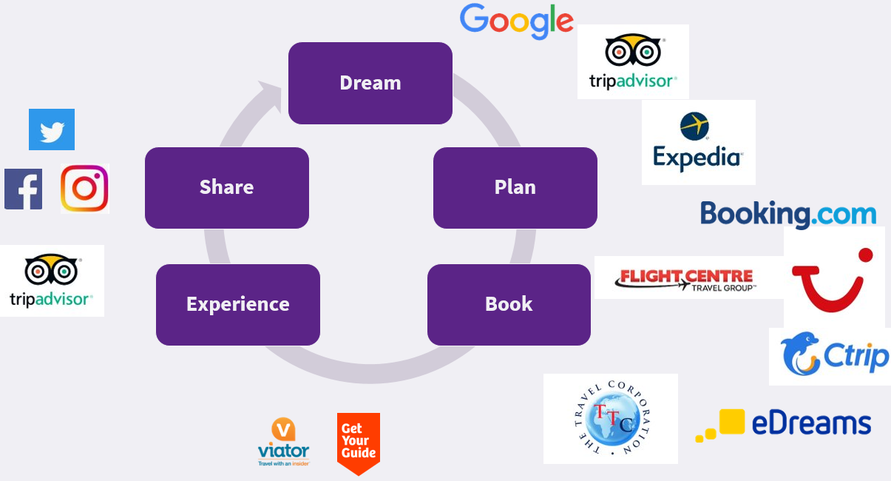
Travel Distribution
Where Visitors Research
Notes:
Because visitors use many ways to research and book it's important to have the right product on those channels.
Each business should know who their customers are, where they come from, what influences their booking decisions and how they purchase.
We will be talking about using insights for both online and offline to ensure your product and its collateral is the best it can be.

Slide 7
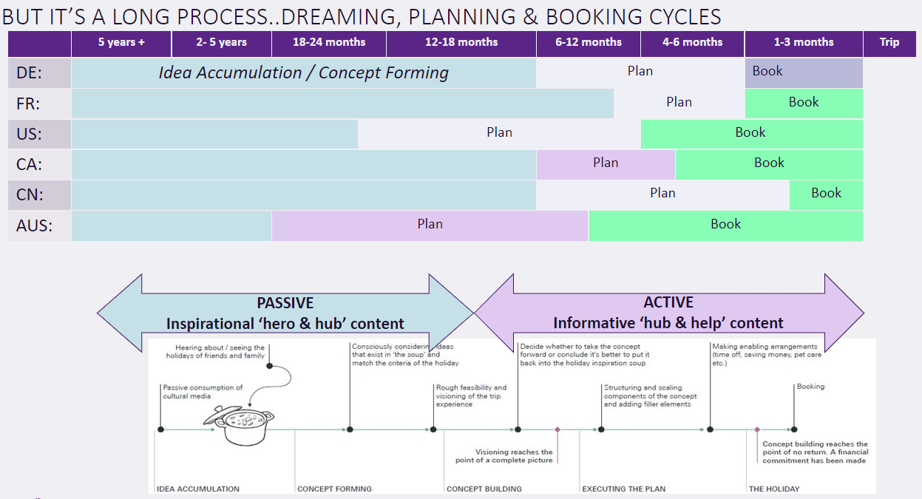

Slide 8
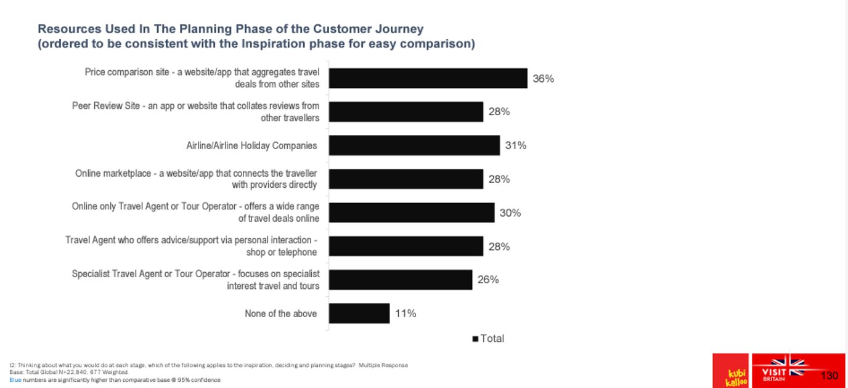
Travel Distribution
Where Visitors Research
Many Information sources
Important to understand your target market
Important to understand different strengths of each channel
Notes:
Because visitors use many ways to research and book it's important to have the right product on those channels.
Each business should know who their customers are, where they come from, what influences their booking decisions and how they purchase.
We will be talking about using insights for both online and offline to ensure your product and its collateral is the best it can be.

Slide 9
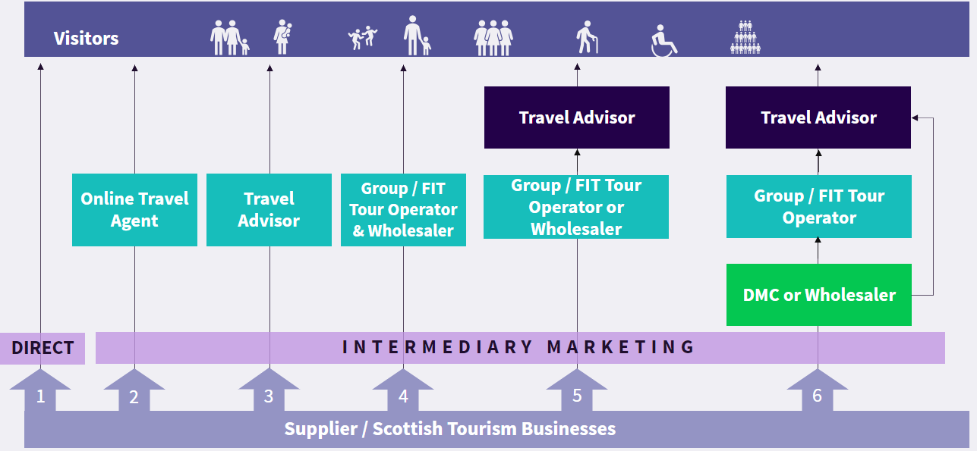
Travel Distribution
How Visitors buy their holiday
(Sources: TripAdvisor; Google; Expedia; VisitBritain)
Notes:
Website/Booking solution
Inbound Tour Operator
Travel agencies/Wholesalers
Destination Management Company(DMC) – Jac travel/Abbey
Online Travel Agent(OTA) – for Experiences Viator(The biggest), Get Your Guide, Expedia(who get their inventory from Viator & GYG) Booking.com(who get their inventory from Viator and Musement), For accommodation – Booking.com, Expedia(are the two biggest) Ctrip for Asia particularly mainland China.
Digital Distribution Channels
Icentres/Hotel Concierges/VisitScotland

Slide 10
Travel Distribution
Online
Connected Distribution
It starts with Tech
Working with Online intermediaries
Notes:
This section covers Online or also defined as connected distribution
We will look at why booking solutions matter and what they offer
How operators, using booking solutions, enable intermediaries to book products and exchange information on products , bookings and customers.
The costs both upfront and often overlooked
And how to have a complete grasp of the costs in order to make the best choices of distribution channels

Slide 11
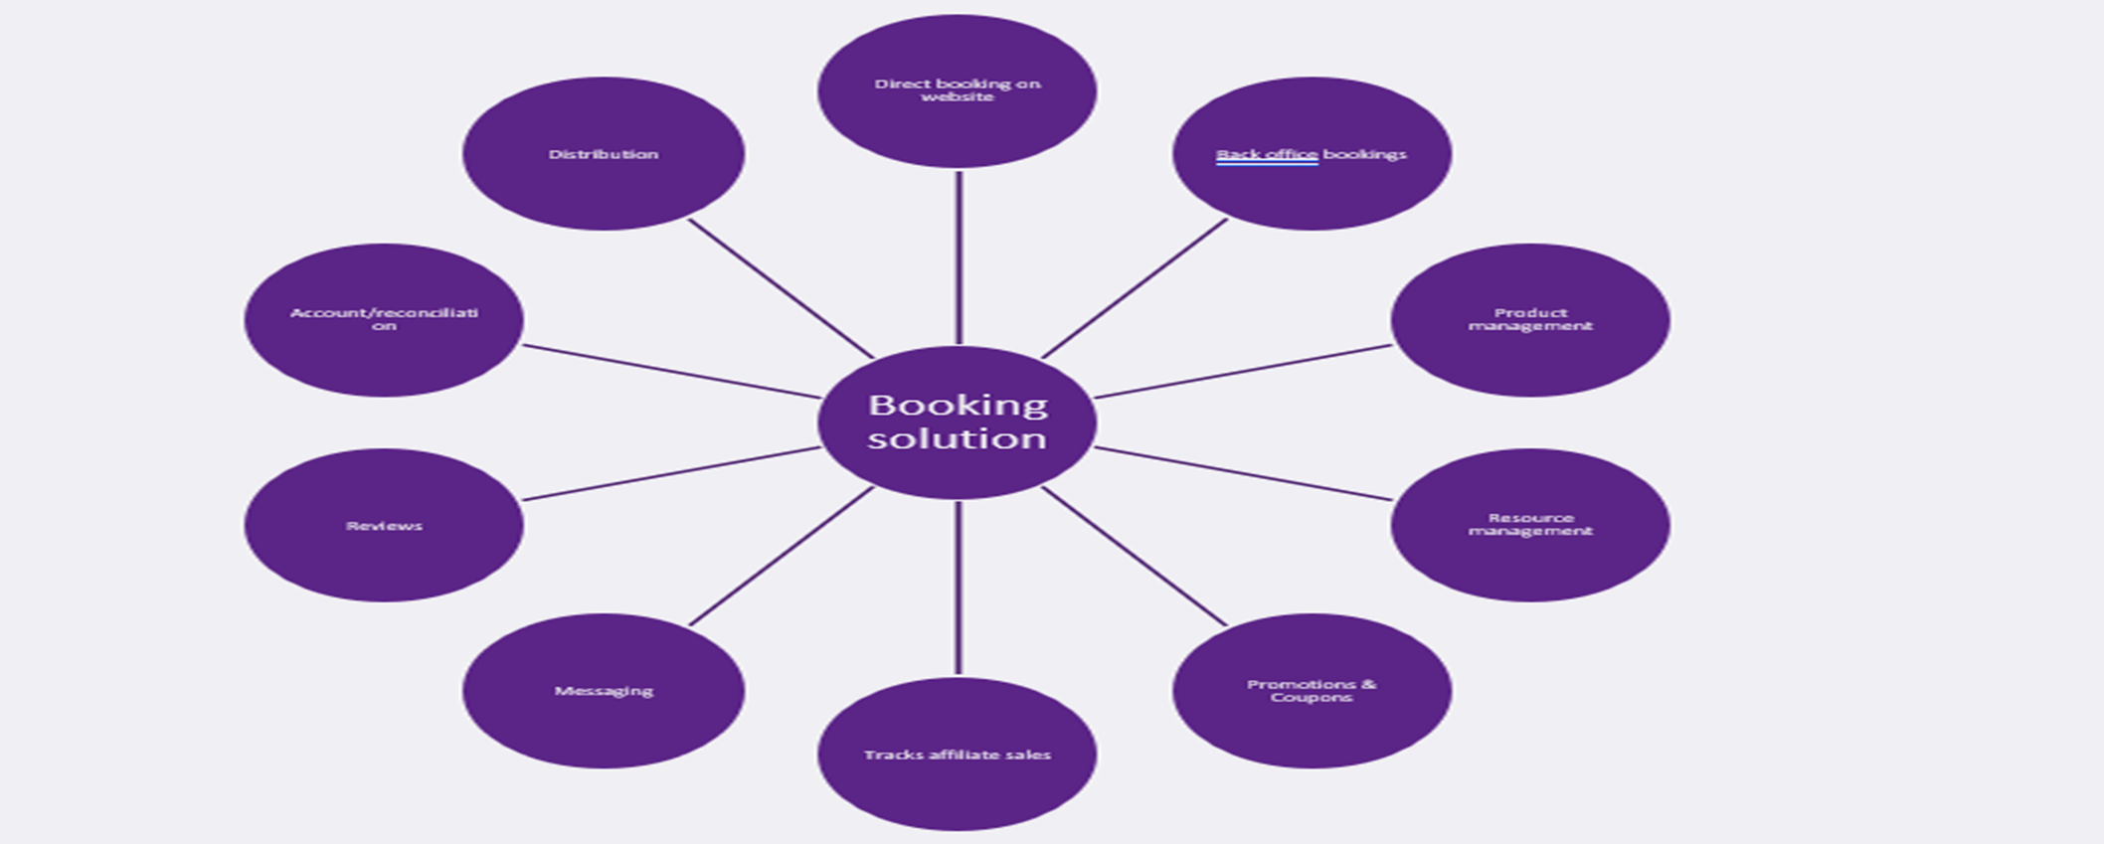
Travel Distribution
Booking systems - benefits
Notes:
Website/Booking solution
Inbound Tour Operator
Travel agencies/Wholesalers
Destination Management Company(DMC) – Jac travel/Abbey
Online Travel Agent(OTA) – for Experiences Viator(The biggest), Get Your Guide, Expedia(who get their inventory from Viator & GYG) Booking.com(who get their inventory from Viator and Musement), For accommodation – Booking.com, Expedia(are the two biggest) Ctrip for Asia particularly mainland China.
Digital Distribution Channels
Icentres/Hotel Concierges/VisitScotland

Slide 12

Travel distribution
Working with Online travel agents
The 6 benefits
Costs and implications

Slide 13
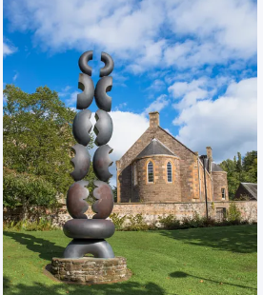
Digital Distribution
6 benefits
Direct
Measurable
OTA’s
Get bookings during low season
Access new markets
Grow your Business
Billboard effect
Notes:
Primary reason – intermediaries bring new bookings and customers
Intermediaries allows you to target new markets such as international(expedia has a large reach in Nth America) or new customer segments Get your Guide(have a strong customer base in active experiences)
You can manage your online availability through intermediaries to limit sales in high season and boost valuable additional sales in low season
As travellers search for inspiration they visit many sites. Being visible on these sites can give brand visibility . Studies have shown that this can lead to direct bookings when visitors visit your own website.
Return on advertising can be difficult but with an OTA you only pay when you get a booking. Its performance based marketing spend.
Your chosen intermediaries should be expert in their own marketplace and give advice on product tweaks and pricing.

Slide 14
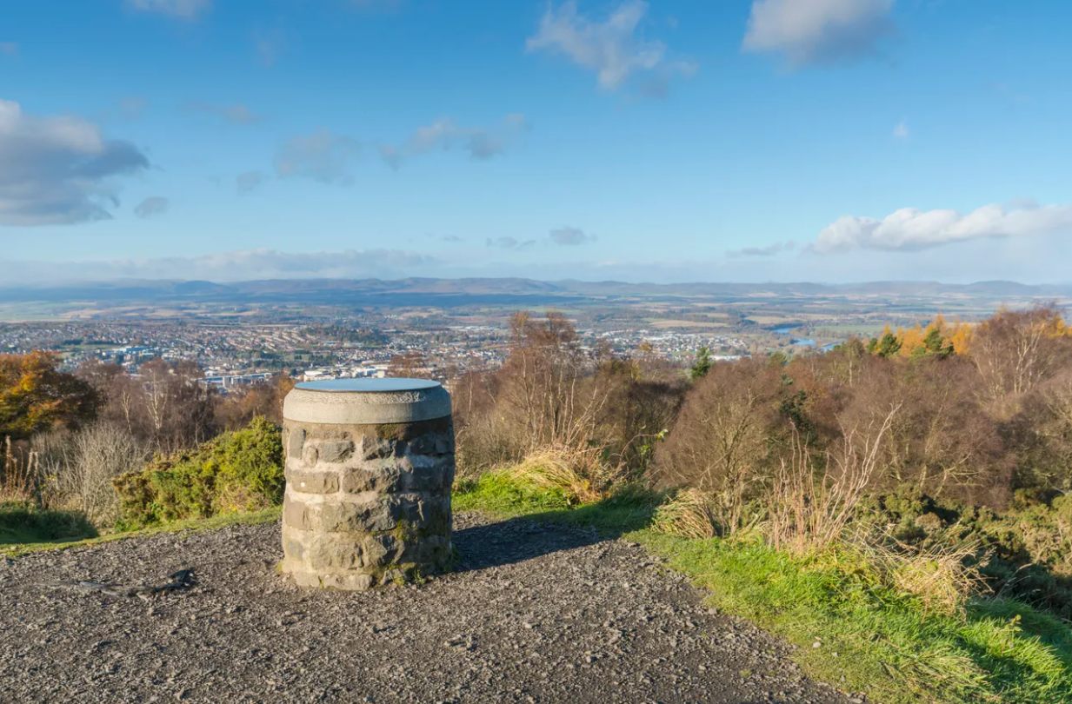
Digital Distribution
Costs and implications
Commision
Limited customer data
Terms & Conditions
Brand awareness
Managing reviews
Operational Impacts
Notes:
Commision – these vary by OTA(can be up to 30% for an experience) and ultimately are a balance between a commission cost and the profitability of the product your distribution viewed alongside the likely additional sales.
Knowing your breakeven point including commission is important.
You should also be aware of additional staffing support/customer service to manage additional sales
Payment processing costs – can be between 1% &2.5%
Data – OTA's will seek to retain as much customer data – allows them to manage the raltionship then and in the future.
There are however ways of collecting data – such as wifi sign up, newsletter signup, review requests etc
T&C's- can cover the “cut-off” window (how close to a tour departure can a distributor sell a ticket), cancellations and refunds, payment terms, insurance requirements, and more.
Brand awareness – although it is now law to show who provides the experience, its not always easy to find that on an OTA's website. Again through use of branded imagery/clothing merchandise its possible to achieve this.
Reviews – its vital that you engage with reviews son a new channel and respond to good and bad. OTA's utilise reviews as one factor to decide how visible you offer is.
Operational impacts – there are quite a few elements to working with an OTA and that is why having a modern booking solution allows a business to seemlessly connect with intermediaries, manage bookings and your workflows.,

Slide 15
FURTHER INFORMATION AND LINKS
Industry Support
Dedicated tourism industry advice. Our experienced team of Industry Relationship managers can be reached at
businesscommunications@visitscotland.com to help with any questions you have about business growth or marketing.
Visitscotland.org: Visit our dedicated business advice section www.visitscotland.org/supporting-your-business
Industry newsletter : Stay up to date with the latest regional and national news by signing up to VisitScotland’s Tourism Insider newsletter at www.visitscotland.org/news
Travel trade links
VisitScotland.org | Visit our dedicated Travel Trade advice pages, including:
Trade jargon buster
Understanding Travel Distribution
How to work with the Travel Trade
Preparing to work with the Travel Trade
Useful travel trade links
VisitBritain - www.visitbritain.org
UKInbound - www.ukinbound.org
European Tour Operator Association (ETOA) - www.etoa.org
Coach Tourism Association (CTA) – www.coachtourismassociation.co.uk
Notes:
To finish I have some handy links and references for you to help understand the travel trade, and our very useful jargon buster; and as with all industries we have our fair share of acronyms.
I’ll now pass on to Patrick who’ll cover

Slide 16

Patrick O’Shaughnessy VisitScotland Industry Manager (Development)

