Slide 1

Perth Museum
Industry Webinar
Anna Day (Service Manager - Public Programming)
Dr Katy Jack (General Manager – Museums)
Ashleigh Hibbins (Head of Audiences and Learning)

Slide 2

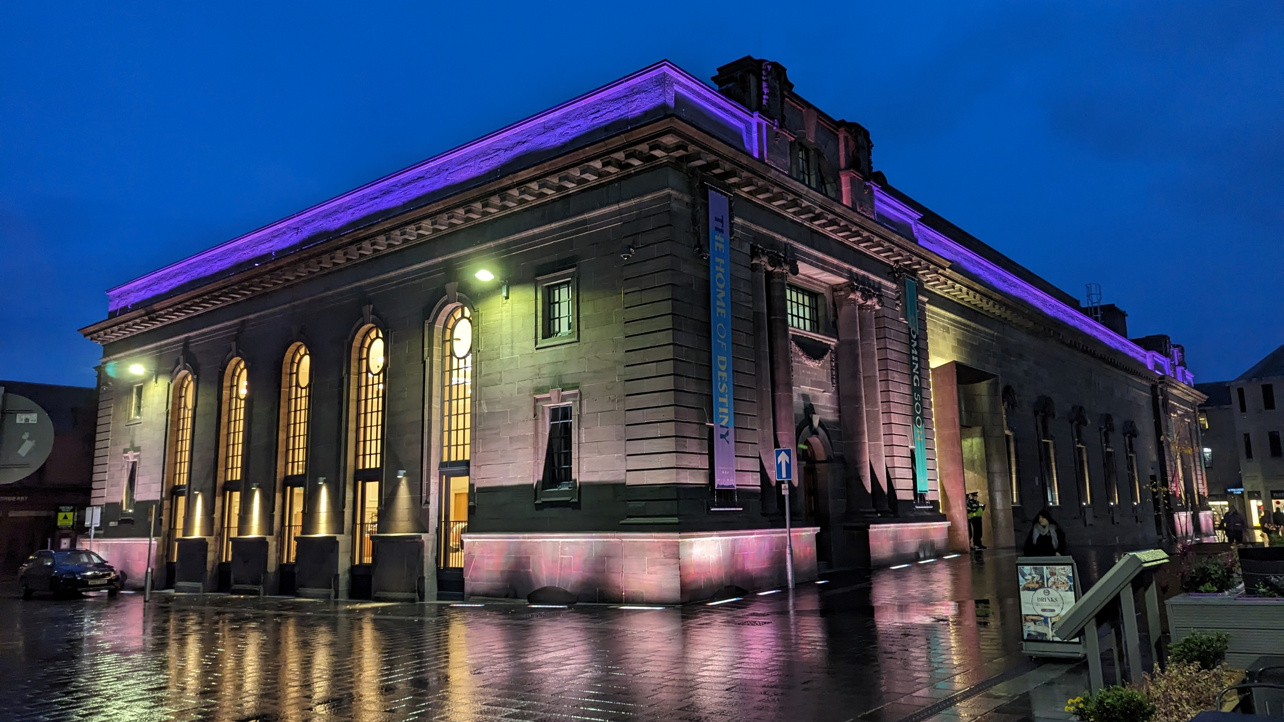
Perth Museum
BLANK FOR ADDING IMAGES/GRAPHICS

Slide 3


aims
Footfall: Minimum target of 137,000 in Y1.
Long-term Goals: Expected to attract an additional 167,000 visitors to Perth by year three, increasing overnight staying visitors by 3% year on year.
Target Audiences:
  Local Audiences: Community co-production, spotlight shows, communities of interest and the education market.
  Day Visitors: Digital Engagement to celebrate the Stone of Destiny.
  Tay City Region – Day and Overnight Visitors: the opening Perth Museum exhibition and wider visitor itineraries.
  International Visitors: Envisaged priority target countries are USA, Germany, Netherlands, France, and Australia.
Enhancing the image and perception of Perth as a place to live and work.​
Growing the visitor economy in the region and supporting the regional tourism strategy.

Slide 4
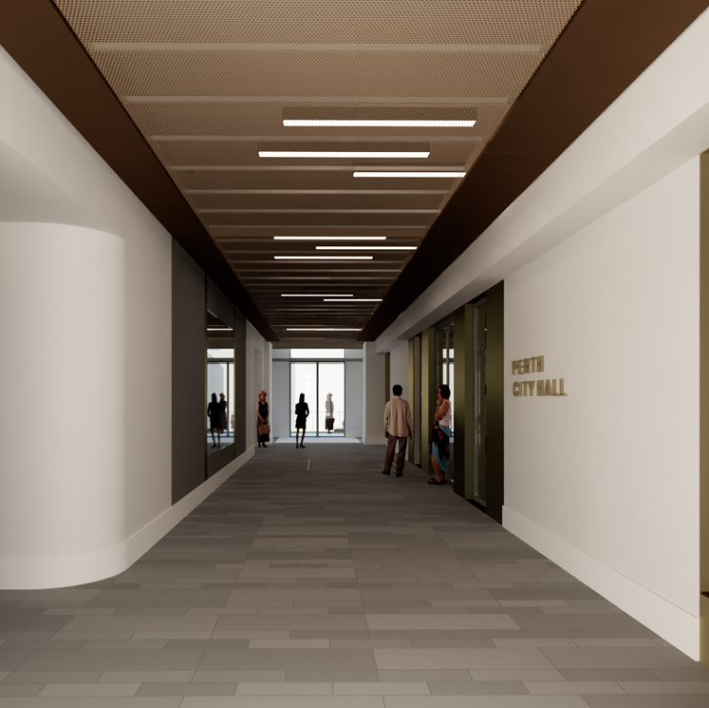
FACILITIES
Toilets (Accessible; Changing Places;
Gender Neutral)
Shop
On-site 70-cover café
Unique venue hire spaces

Slide 5
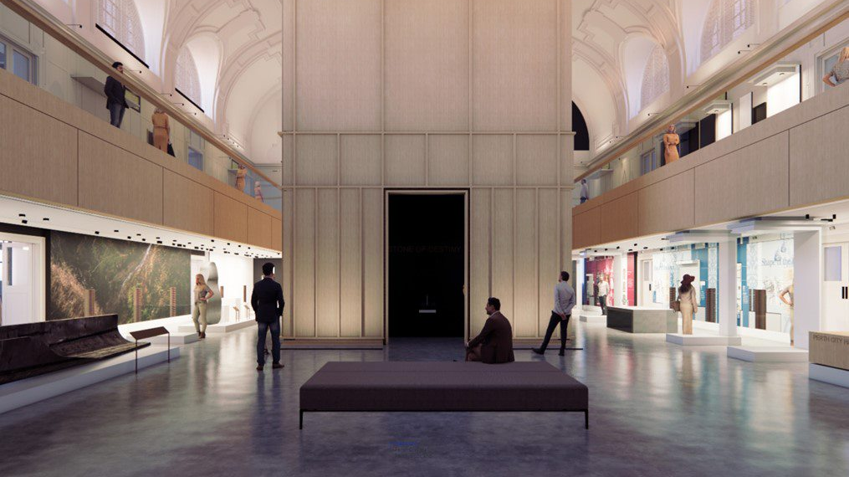
Stone of Destiny

Slide 6
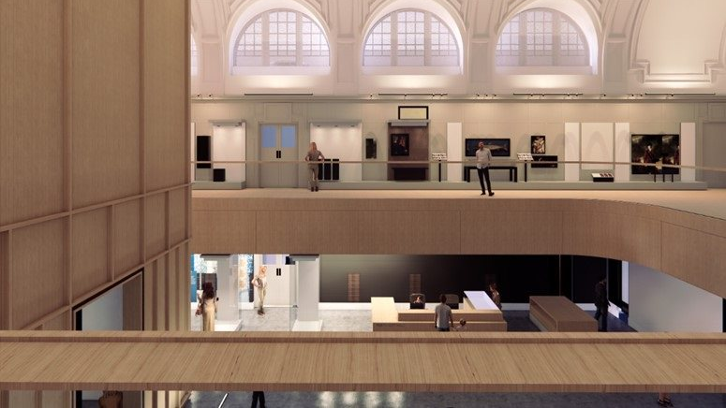
Perth at the heart of Scotland’s story

Slide 7
Visitor experience | TRAVEL TRADE
VisitScotland Quality Assurance Scheme
Fully accessible experience
Engagement with Travel Trade to increase footfall
Exciting and memorable programme of unique experiences
Collaborative potential throughout the region
Strong and growing interest in the Perth product
Due to open in March 2024, the museum will offer visitors a 5*, fully accessible and captivating experience that inspires them to explore Scotland’s past and its connection to the wider world.

Slide 8
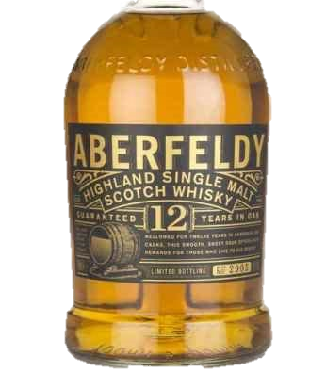
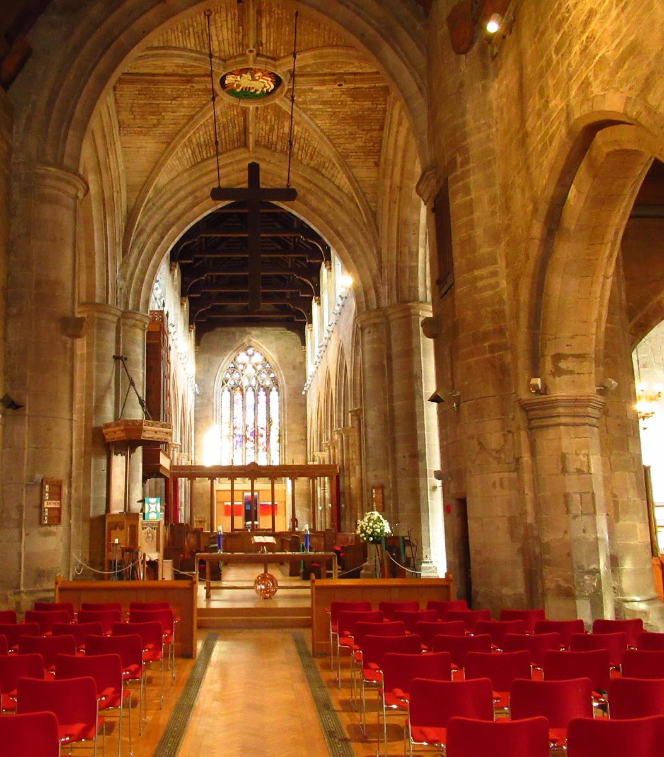
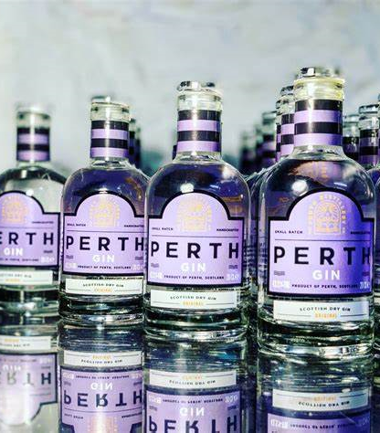
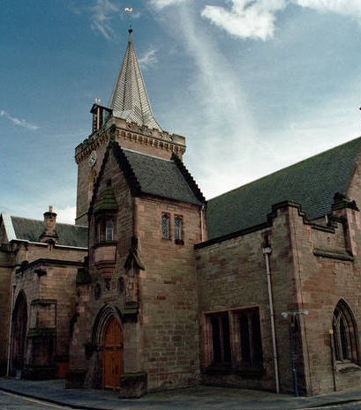
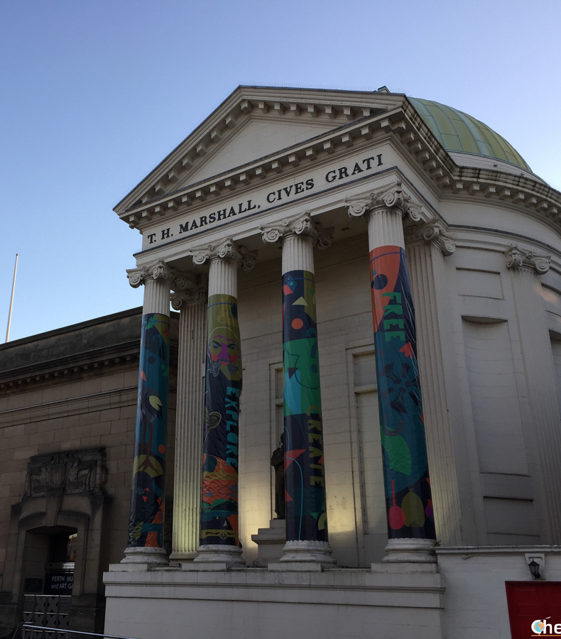
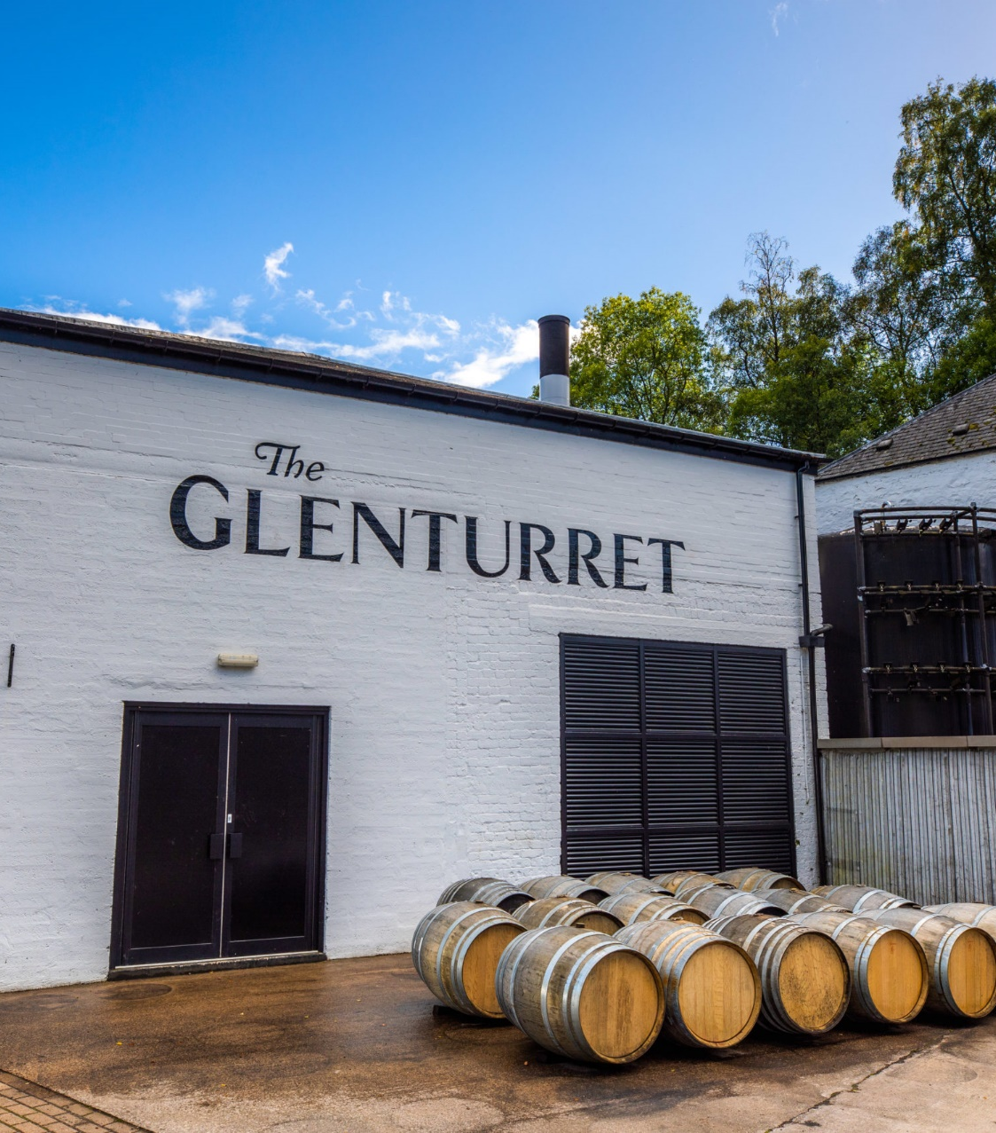
collaboration

Slide 9
Getting involved
Sponsorship packages for local and national brands
Designed to extend the reach and impact of Perth Museum
How?
  Helping to develop the region
  Unlocking the impact of local heritage
  Creating jobs and career development opportunities
  For more information, contact Robin Patel, Fundraising Officer
  rmpatel@culturepk.org.uk / 01738 444949
Benefits?
Brand promotion
Support-in-kind
Corporate hospitality and employee benefits
‘Behind-The-Scenes’ Tours/Talks

Slide 10
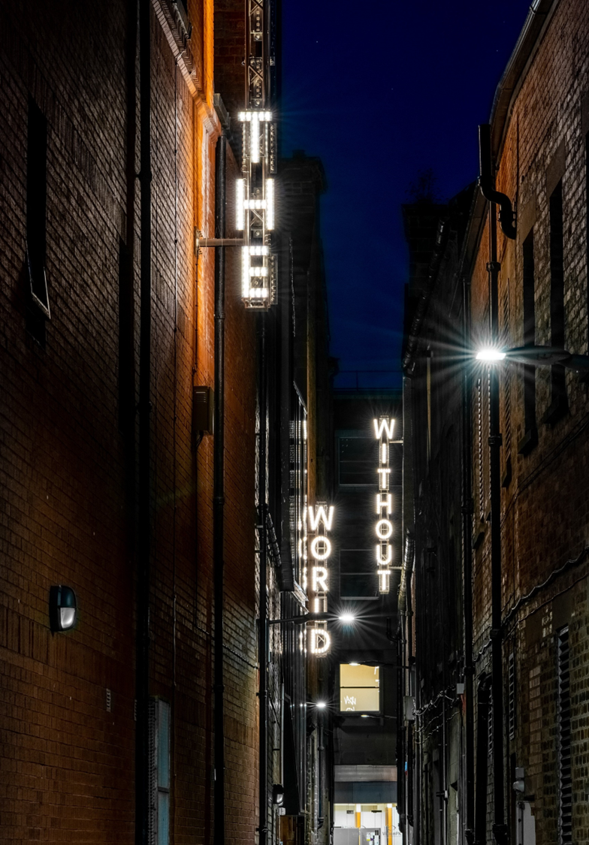
Cultural Investment
£53million pounds spent over the last decade on raising the cultural profile in Perth including:
Perth Theatre
Perth Concert Hall
St Paul’s Church
Perth City of Light
Creative Exchange
Additionally we spend annually on libraries, art galleries, Pitlochry Festival Theatre and community arts projects.
Notes:
A maximum 167,000 additional visitors to Perth by Year 3 of opening – ​
An average additional £2.5m GVA annually (to Perth and Kinross) - average over 10 years​
An average additional £1.0M GVA annually (to Scotland) – average over 10 years​
£101.1m additional gross visitor expenditure generated over 10 years​
19.7FTE direct employment opportunities (21 FTEs at P&K level; 14 FTEs at Scotland level; 3 FTEs at UK level).​
1,500 volunteering opportunities and 30 community enterprises.

Slide 11
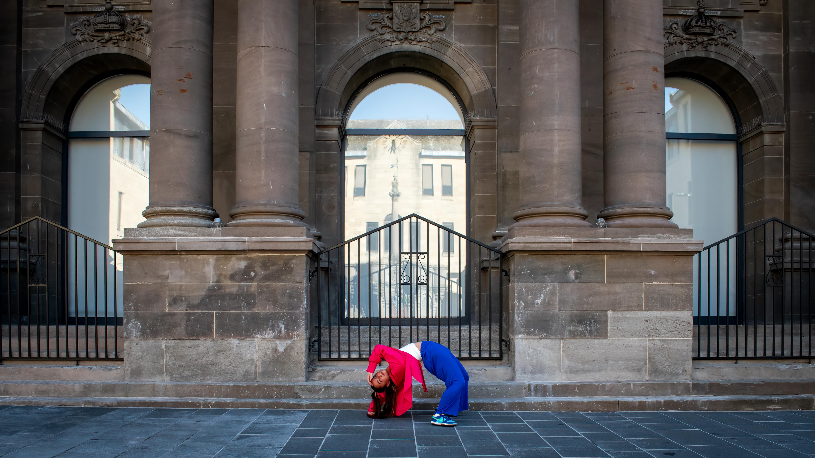

Slide 12
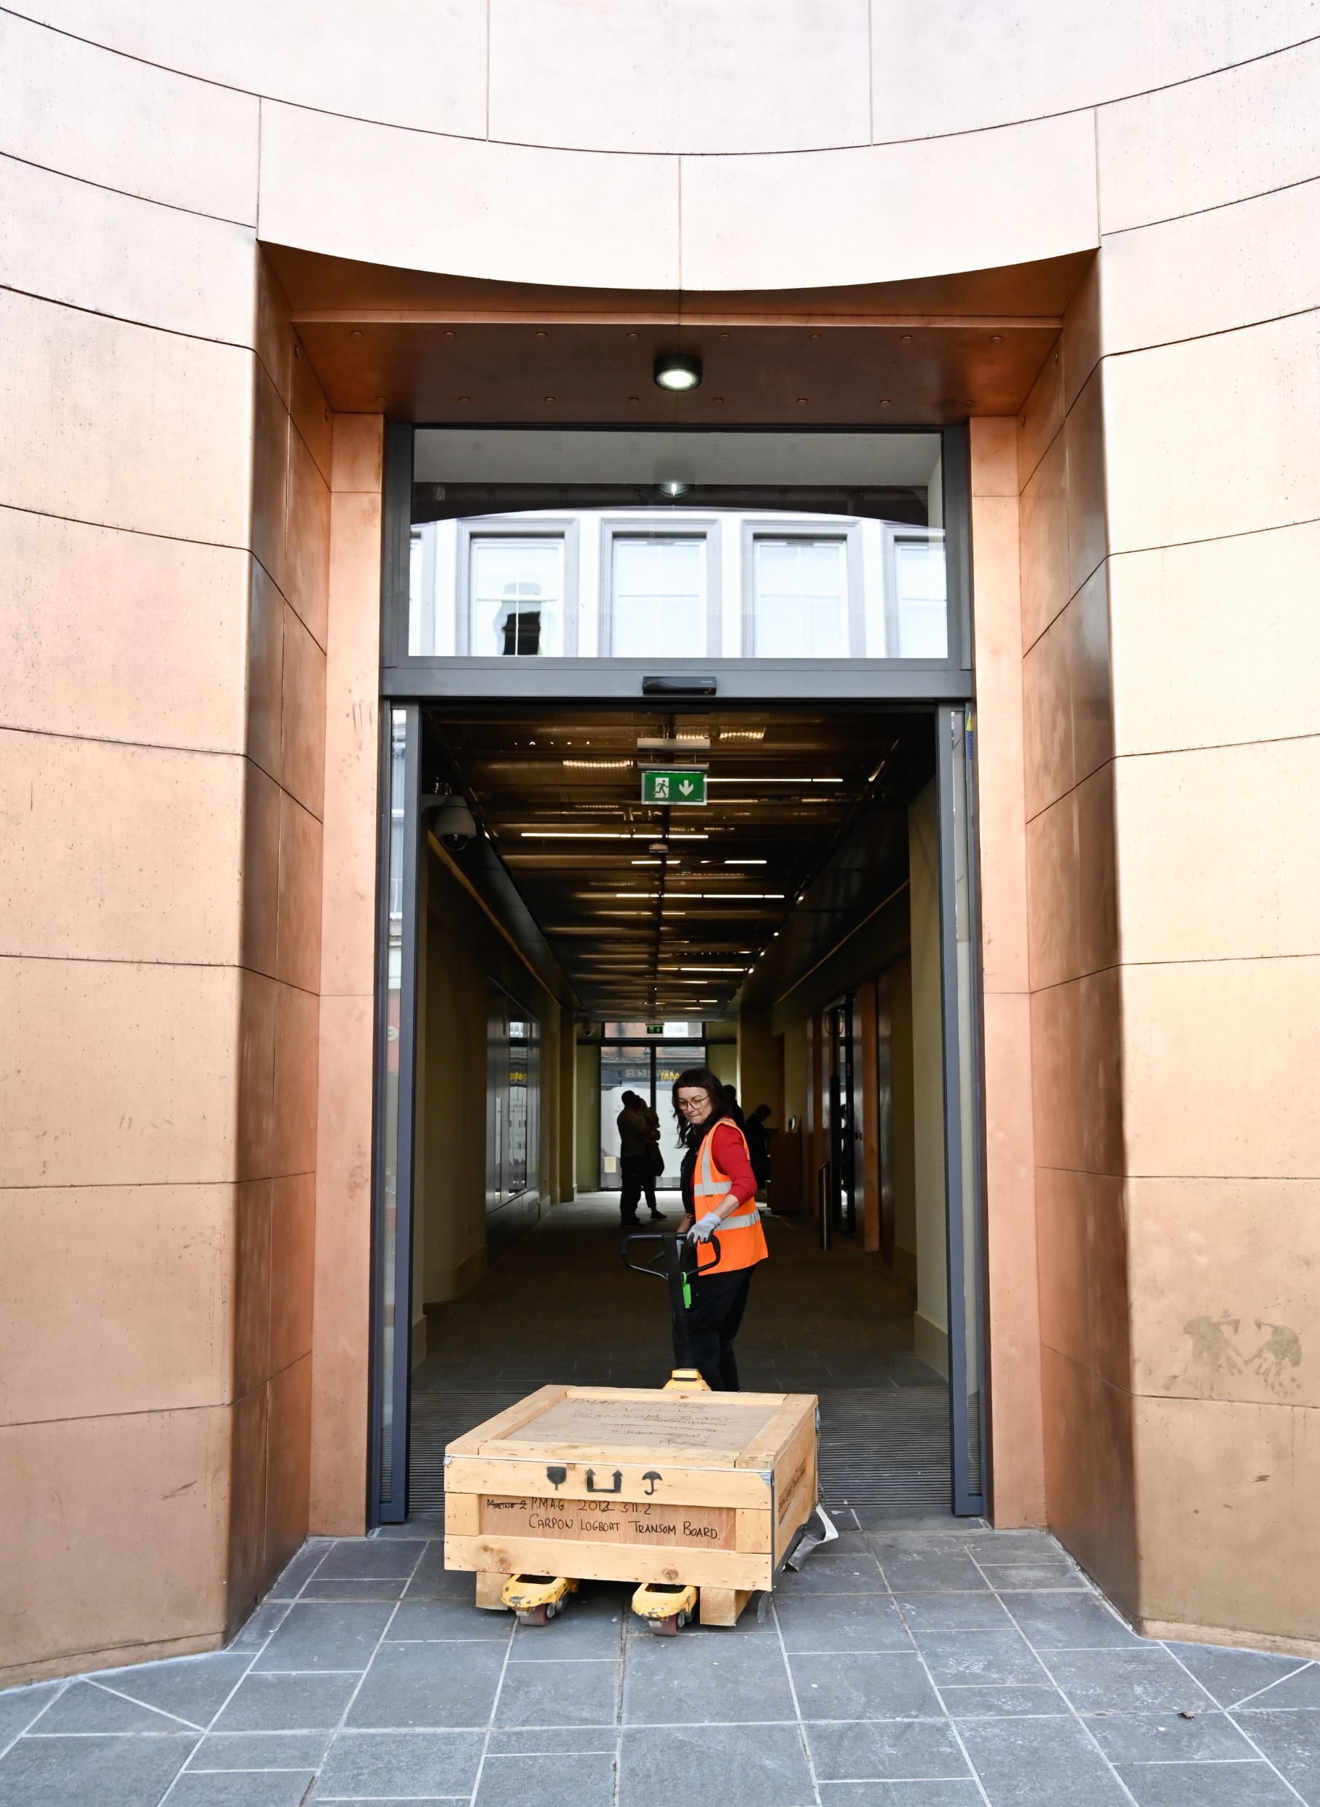
Opening programme
Community and stakeholder previews
Major new temporary exhibition with international profile (announcing Jan 2024)
Family-focused Easter half-term activities across the Museum, Perth Art Gallery, and city centre
Programme which includes activity from across P&K to ensure the whole area benefits
Full programme of events announced in February

Slide 13
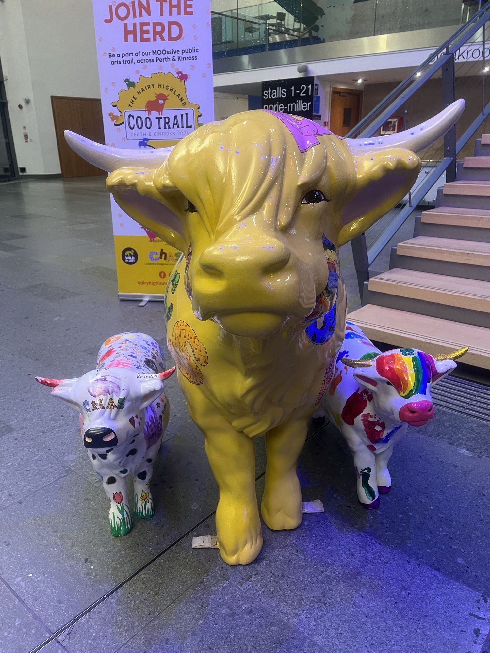
Perth’s summer of celebration
March 2024 Museum opening – a weekend of celebration across Perth and Kinross
April 2024 Two weeks of family-focussed fun and free workshops
April 2024 Crannog reopens on new site
May 2024 Cocktail Week
June 2024 Hairy Coo Trail
July 2024 New exhibition in Perth Art Gallery
September 2024 Restaurant Week
Text here

Slide 14
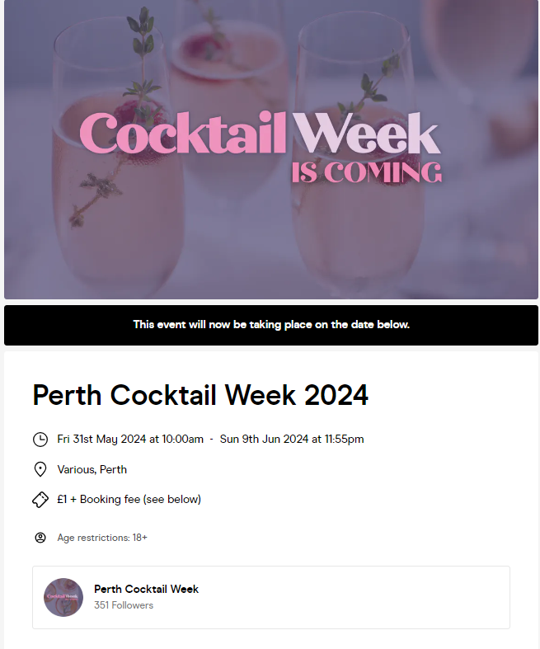
Perth Museum opportunities
Cocktail Week and Restaurant Week – free sign up
Coach Friendly Status - update
Press trip opportunities
Building a narrative for the city
Perthshire Box Office / Perth City and Towns What’s On guide
Toolkit launched in early March
Hashtags:
#loveperth
#perthcityofstories
#perthlivelifewell

Slide 15

Thank you
Dr Katy Jack (kjack@culturepk.org.uk)
Anna Day (aday@pkc.gov.uk)

