Slide 1
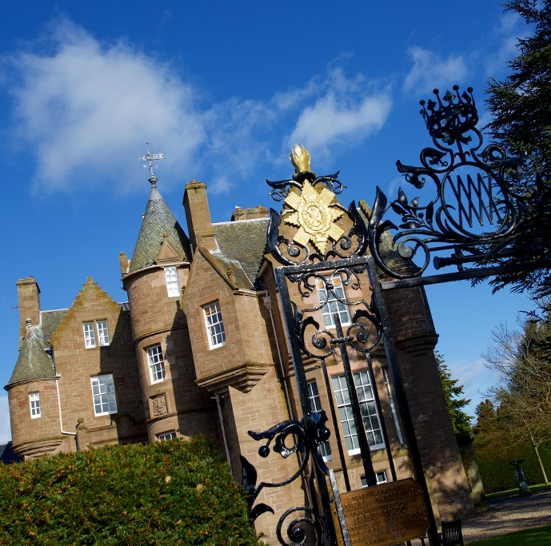

The Black Watch Castle and Museum
The Hauntings
1st July – 12th November 2023

Slide 2
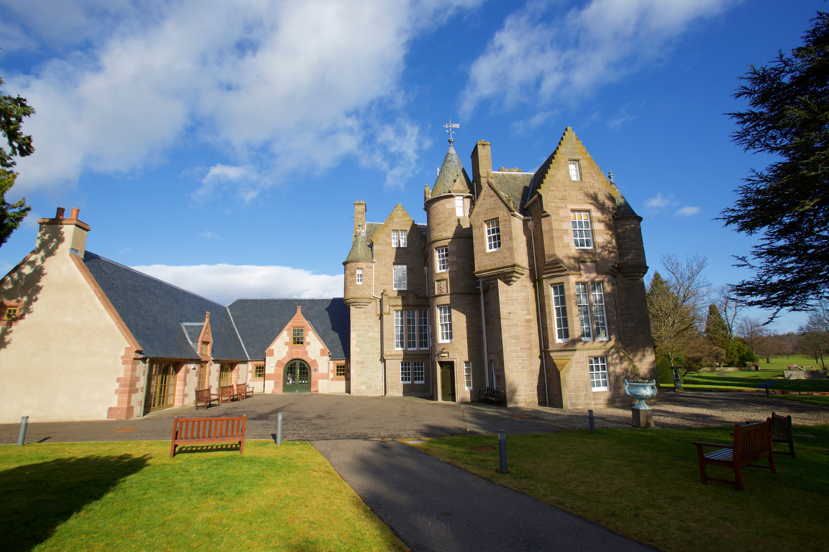
The Hauntings
1 July – 12 November 2023
Notes:
ABOUT US:

Slide 3

Something BIG is coming to Perth this Summer!

Slide 4
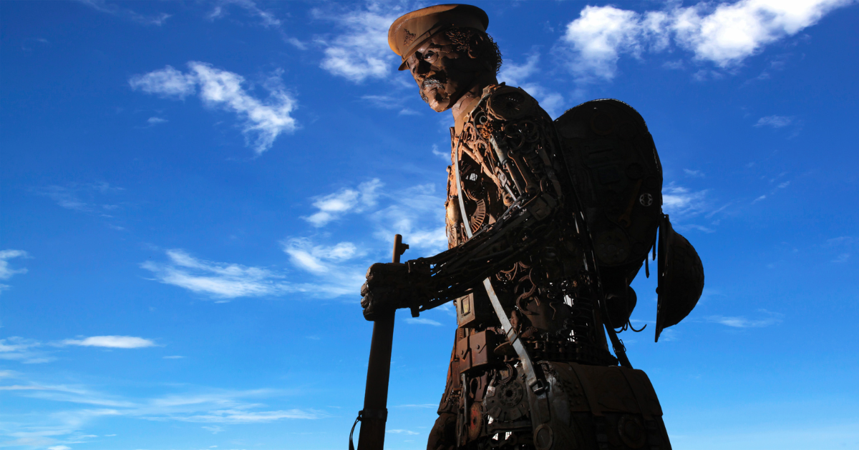
The Black Watch Castle and Museum
1 July – 12 November 2023
1st July to 31st August
Culture in the community
1st September to 31st October
The impact of conflict
1st November to 12th November
Remembrance and commemoration
Notes:
Our Themes

Slide 5
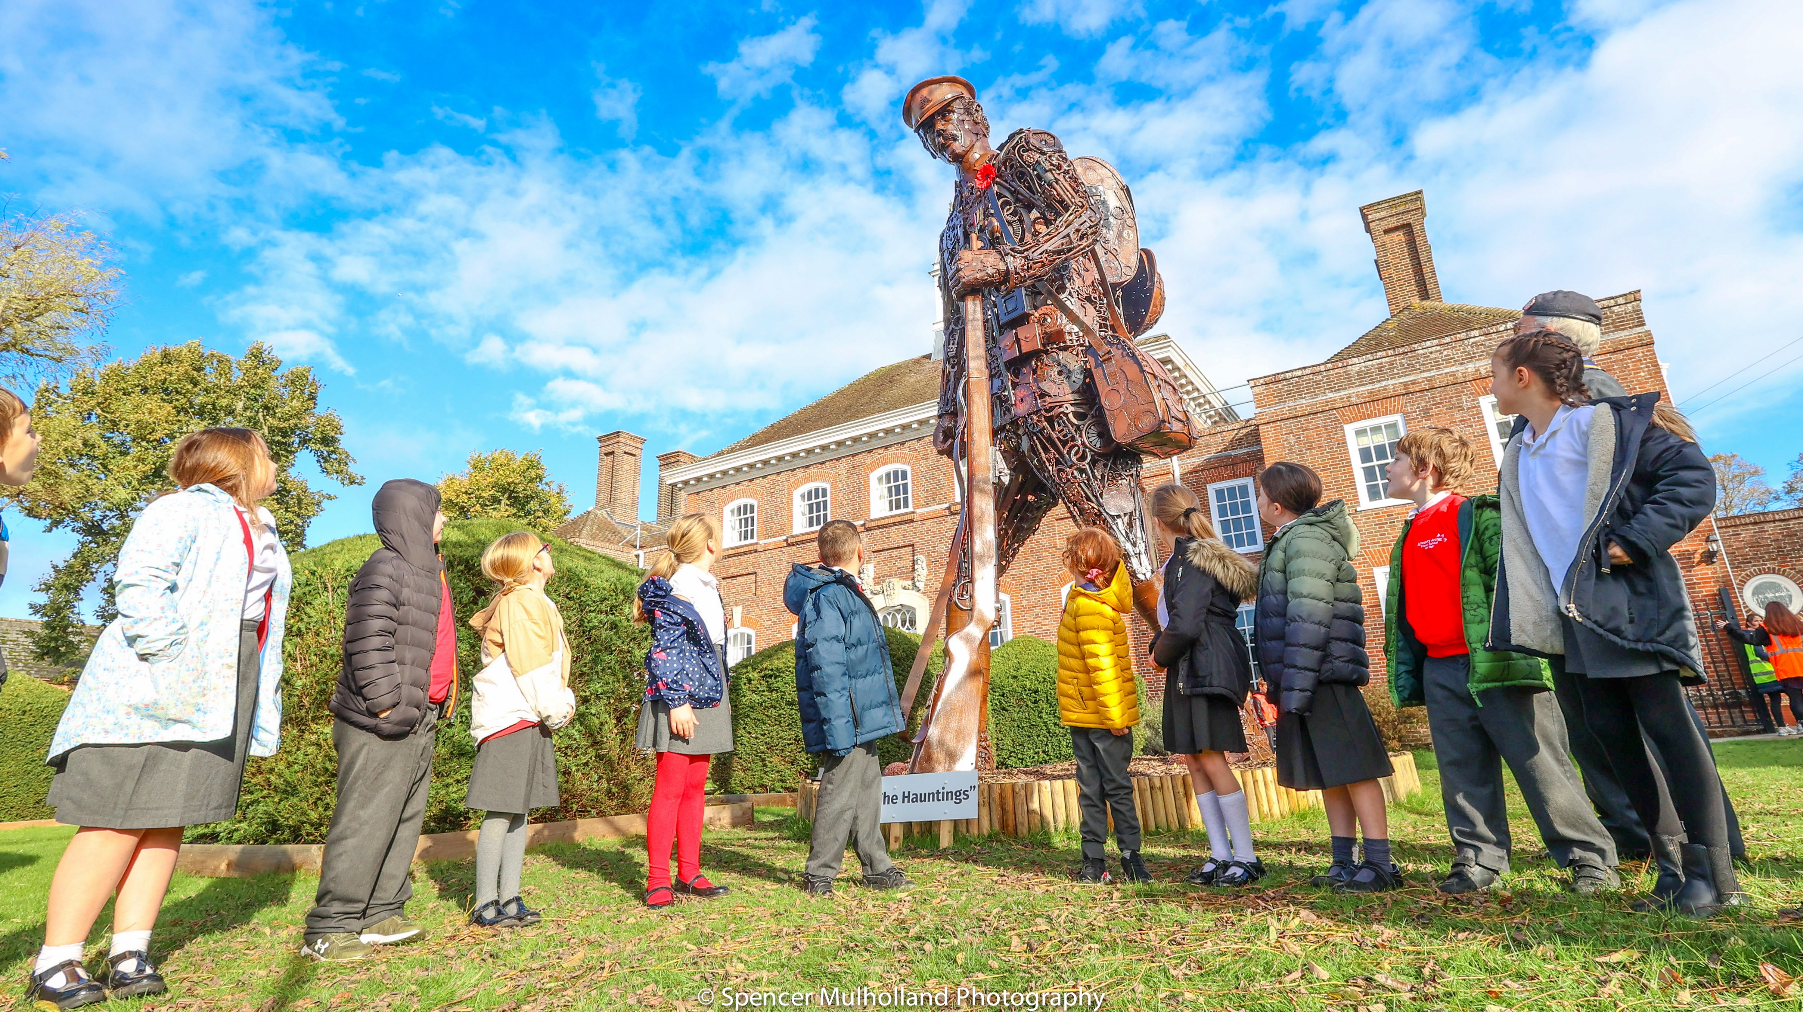
The Black Watch Castle and Museum
1 July – 12 November 2023
1st July to 31st August
Culture in the community
1st September to 31st October
The impact of conflict
1st November to 12th November
Remembrance and commemoration
Notes:
Our Themes

Slide 6
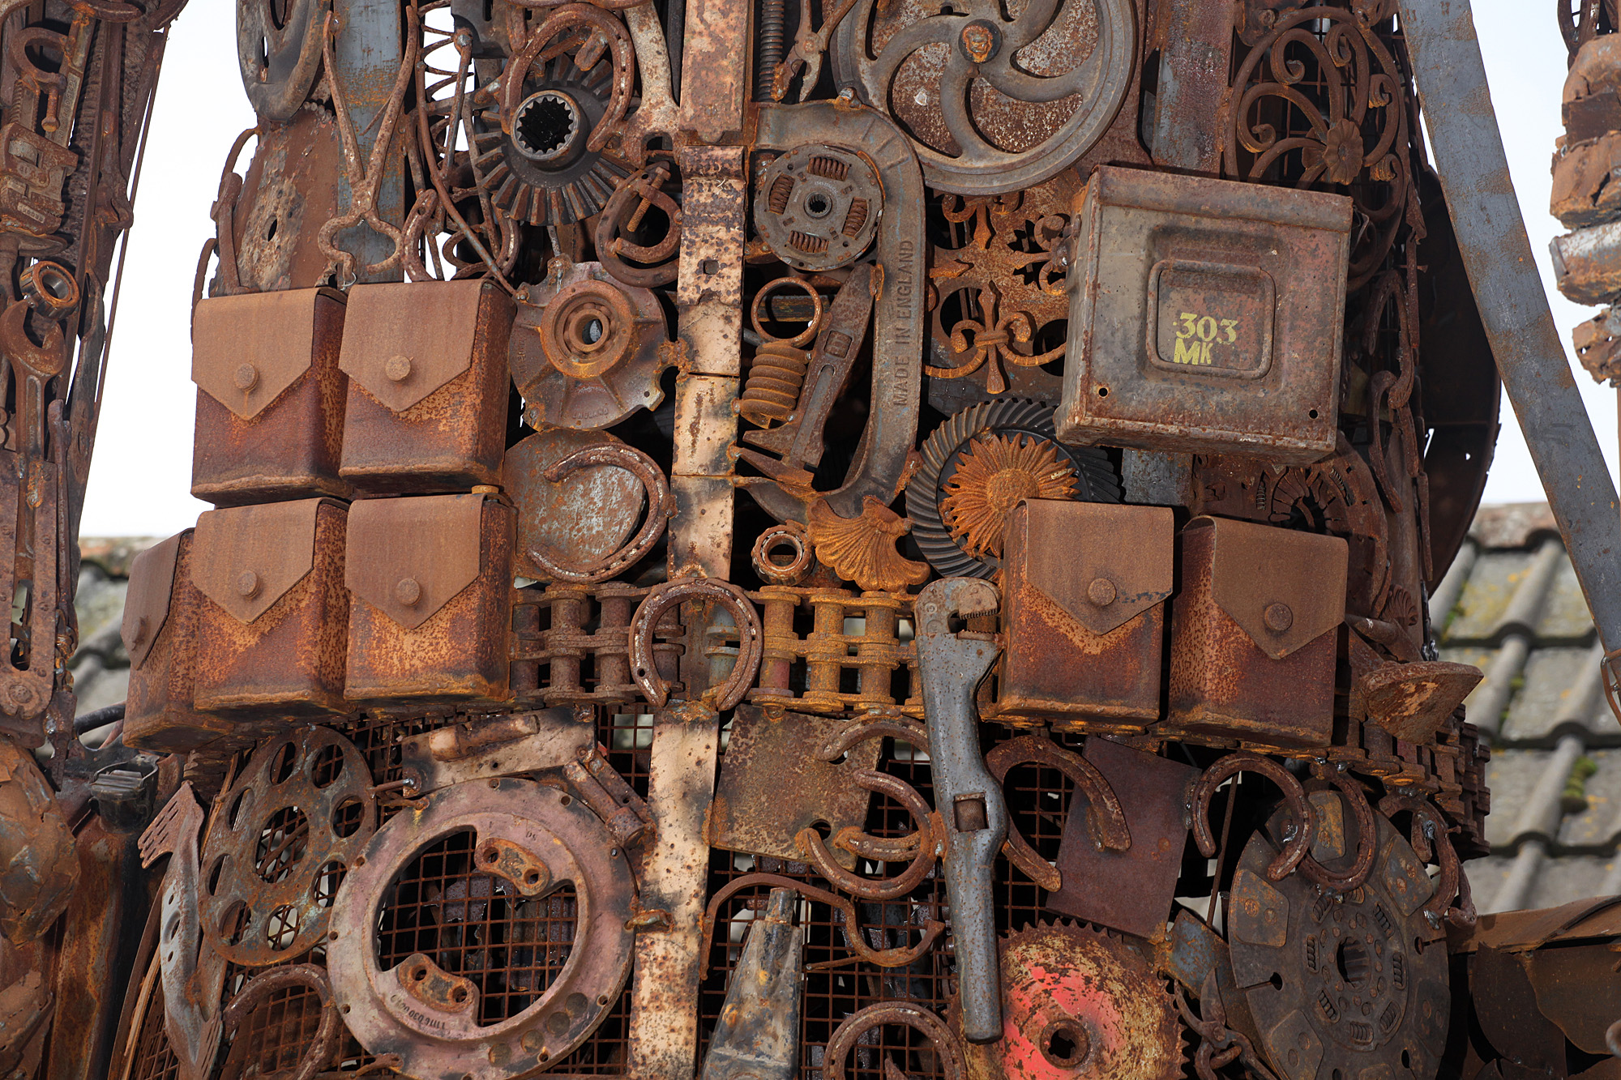
The Black Watch Castle and Museum
1 July – 12 November 2023
1st July to 31st August
Culture in the community
1st September to 31st October
The impact of conflict
1st November to 12th November
Remembrance and commemoration
Notes:
Our Themes

Slide 7
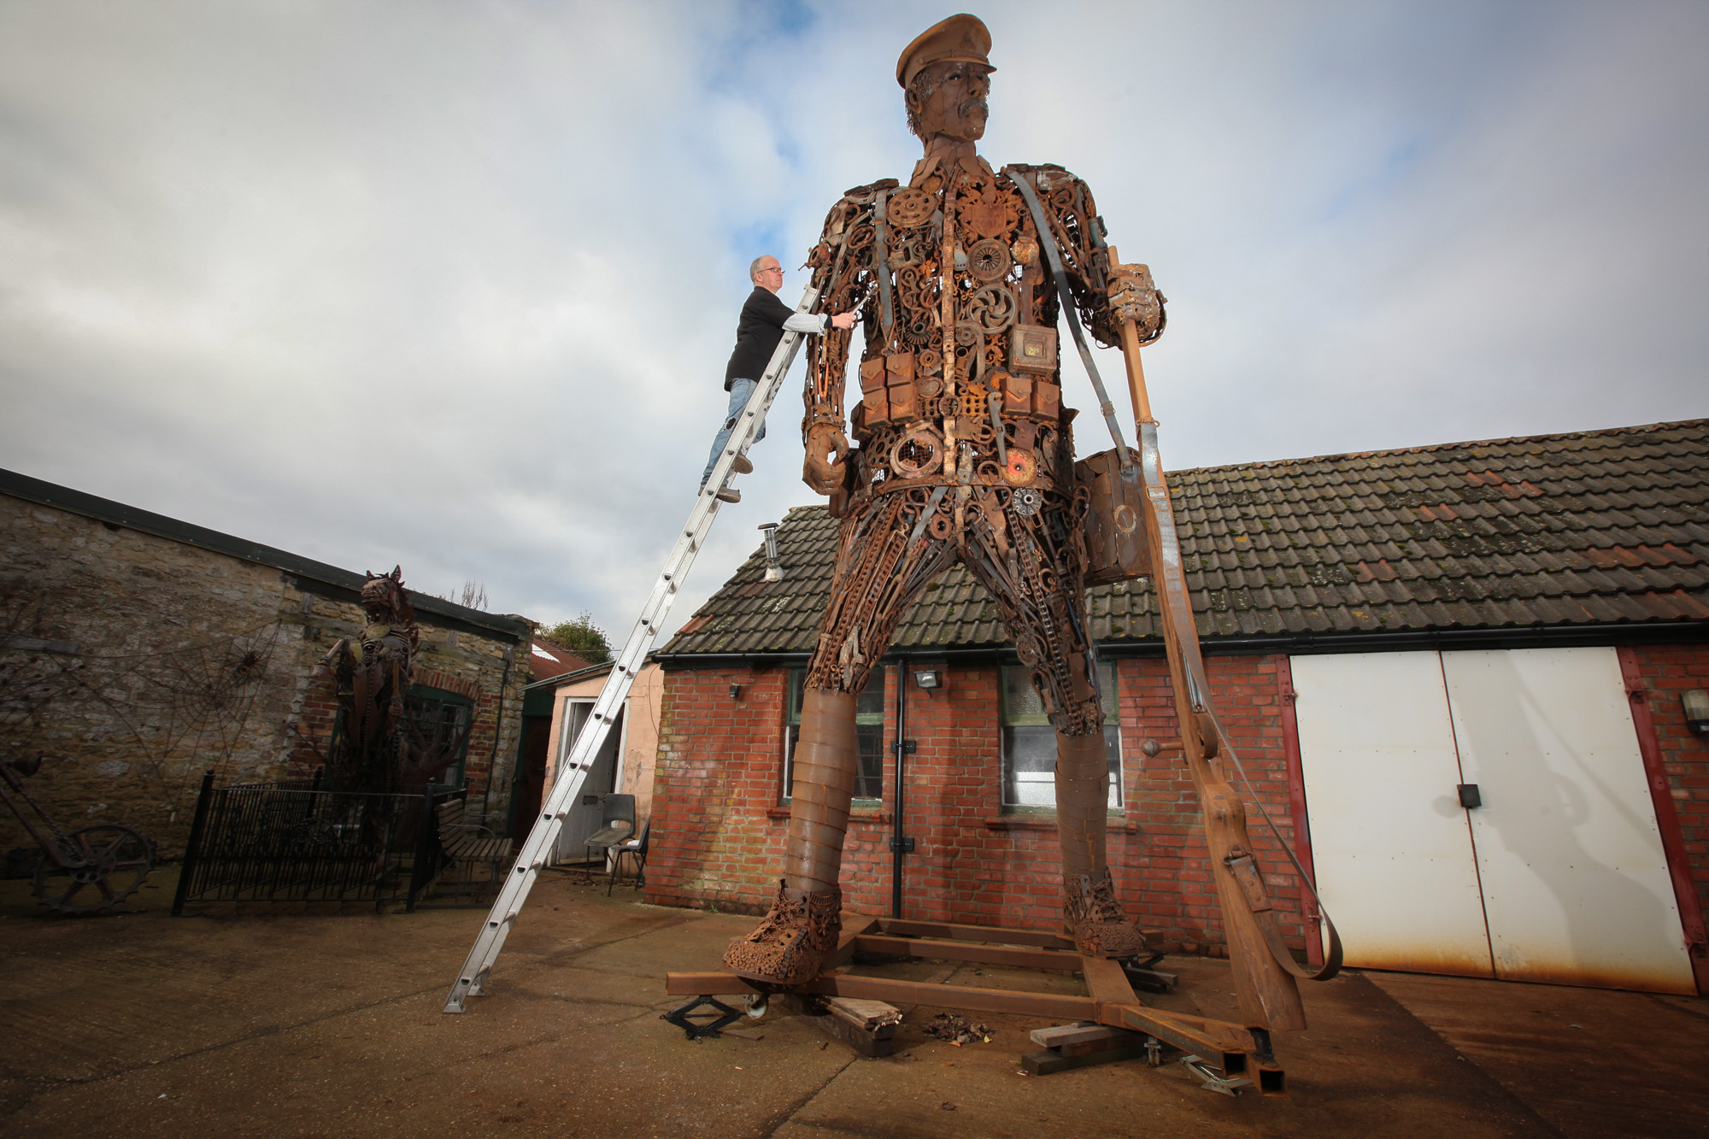
The Hauntings
His Travels
Notes:
About The Hauntings

Slide 8
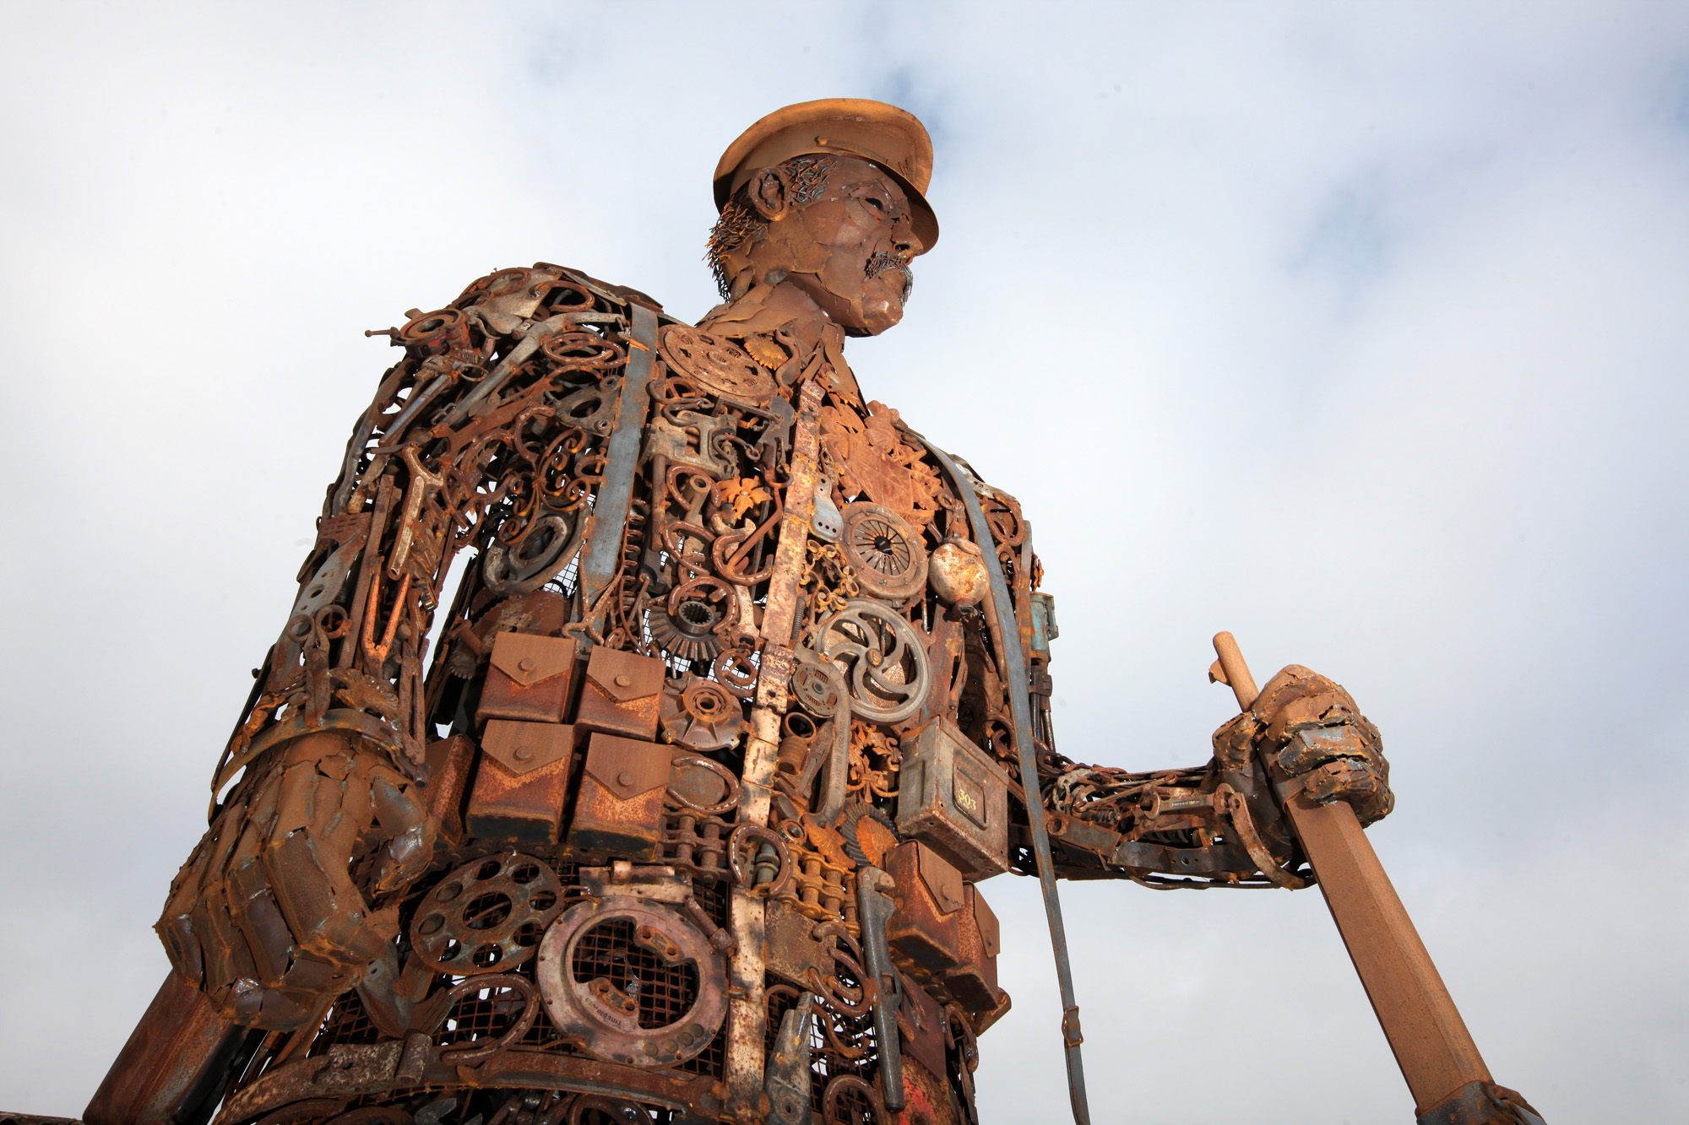
The Hauntings
His Travels
Notes:
About The Hauntings

Slide 9

Linda Campbell |Department Head | Finance
01738 638152 Ex 210
linda@theblackwatch.co.uk
Leanor Blackhall| Marketing and Commercial Executive
01738 638152 Ex 212
leanor@theblackwatch.co.uk

