Slide 1
Atholl Estates – Post pandemic and into the future
Julia Sim – Head of Sales

Slide 2
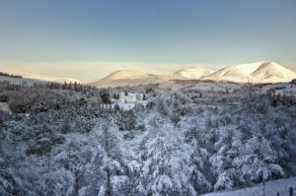
History of Atholl
145,000 acres of Highland Perthshire
Blair Castle and Gardens at its heart
Blair Castle Caravan Park
Self catering accommodation
Farming
Woodland
Country pursuits

Slide 3
2019-2022 the story so far!
2019
150,000 visitors
Record breaking year
2020
did it even happen?
2021
25,000 visitors
2022
105,000 visitors
2019 – booming groups and travel trade, emerging markets from Australia, UAE, Canada and South America
2020 – don’t even!
2021 – UK domestic market opened but very slow to recover
2022 – Slow start but travel corridors opened from US which brough late surge in travellers from late July onwards, European market slower to return, especially Germany.

Slide 4
How have we reacted?
Diversified
Build on what we have available – acres of hills and glens
Adventure tourism
Bikes
Hikes
Created new exhibition in the Castle
Launched Smartify App with audio tours now available in 4 languages dictated by our staff
Rebranded and launched new website
Running

Slide 5
Going forward…
They say its going to take until 2025 to see us back to where we were in 2019 so what are we doing to try and accelerate this process?
Sales mission – get back out seeing my customers, UKI, VS BDM, ITB, UK and Ireland show, VS show.
Keep building on the new outdoor large scale events be centre of adventure tourism for Highland Perthshire.
Atholl Estates investing in – self catering property, regenerative farming, peat restoration, woodland creation.
Filming

Slide 6
Major headaches ahead…
Staffing levels and accommodation
Rise of energy prices
Cost of food and supply chain
Cost of living crisis
Value for money vs costs
£ vs $
Booking windows vastly reduced so impossible to budget accordingly

Slide 7
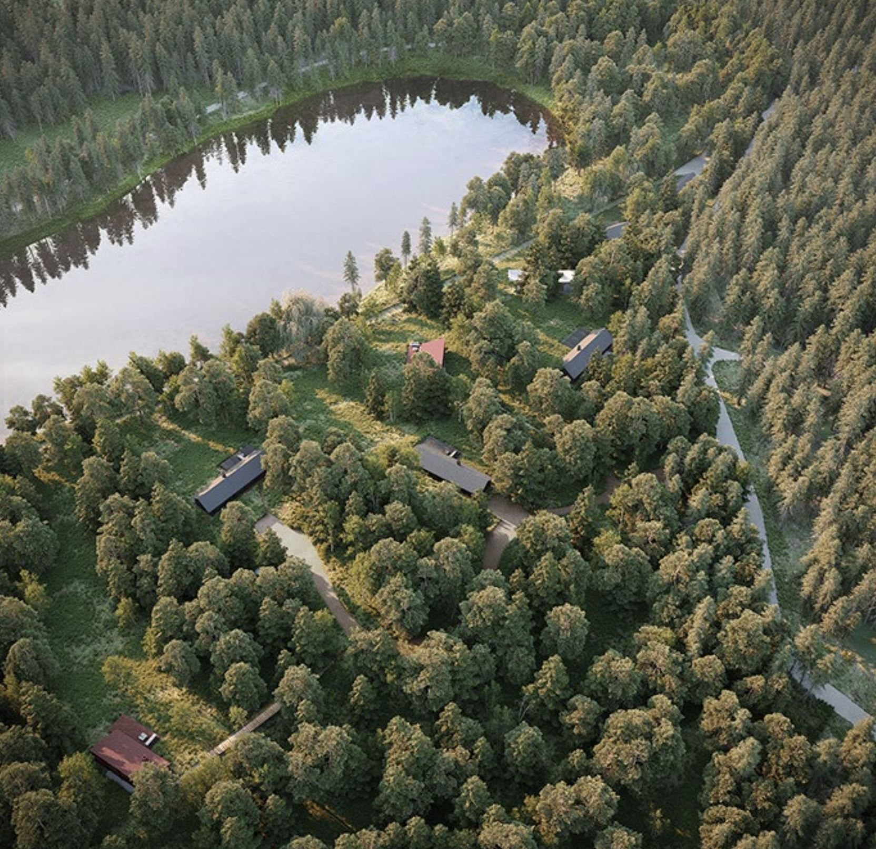
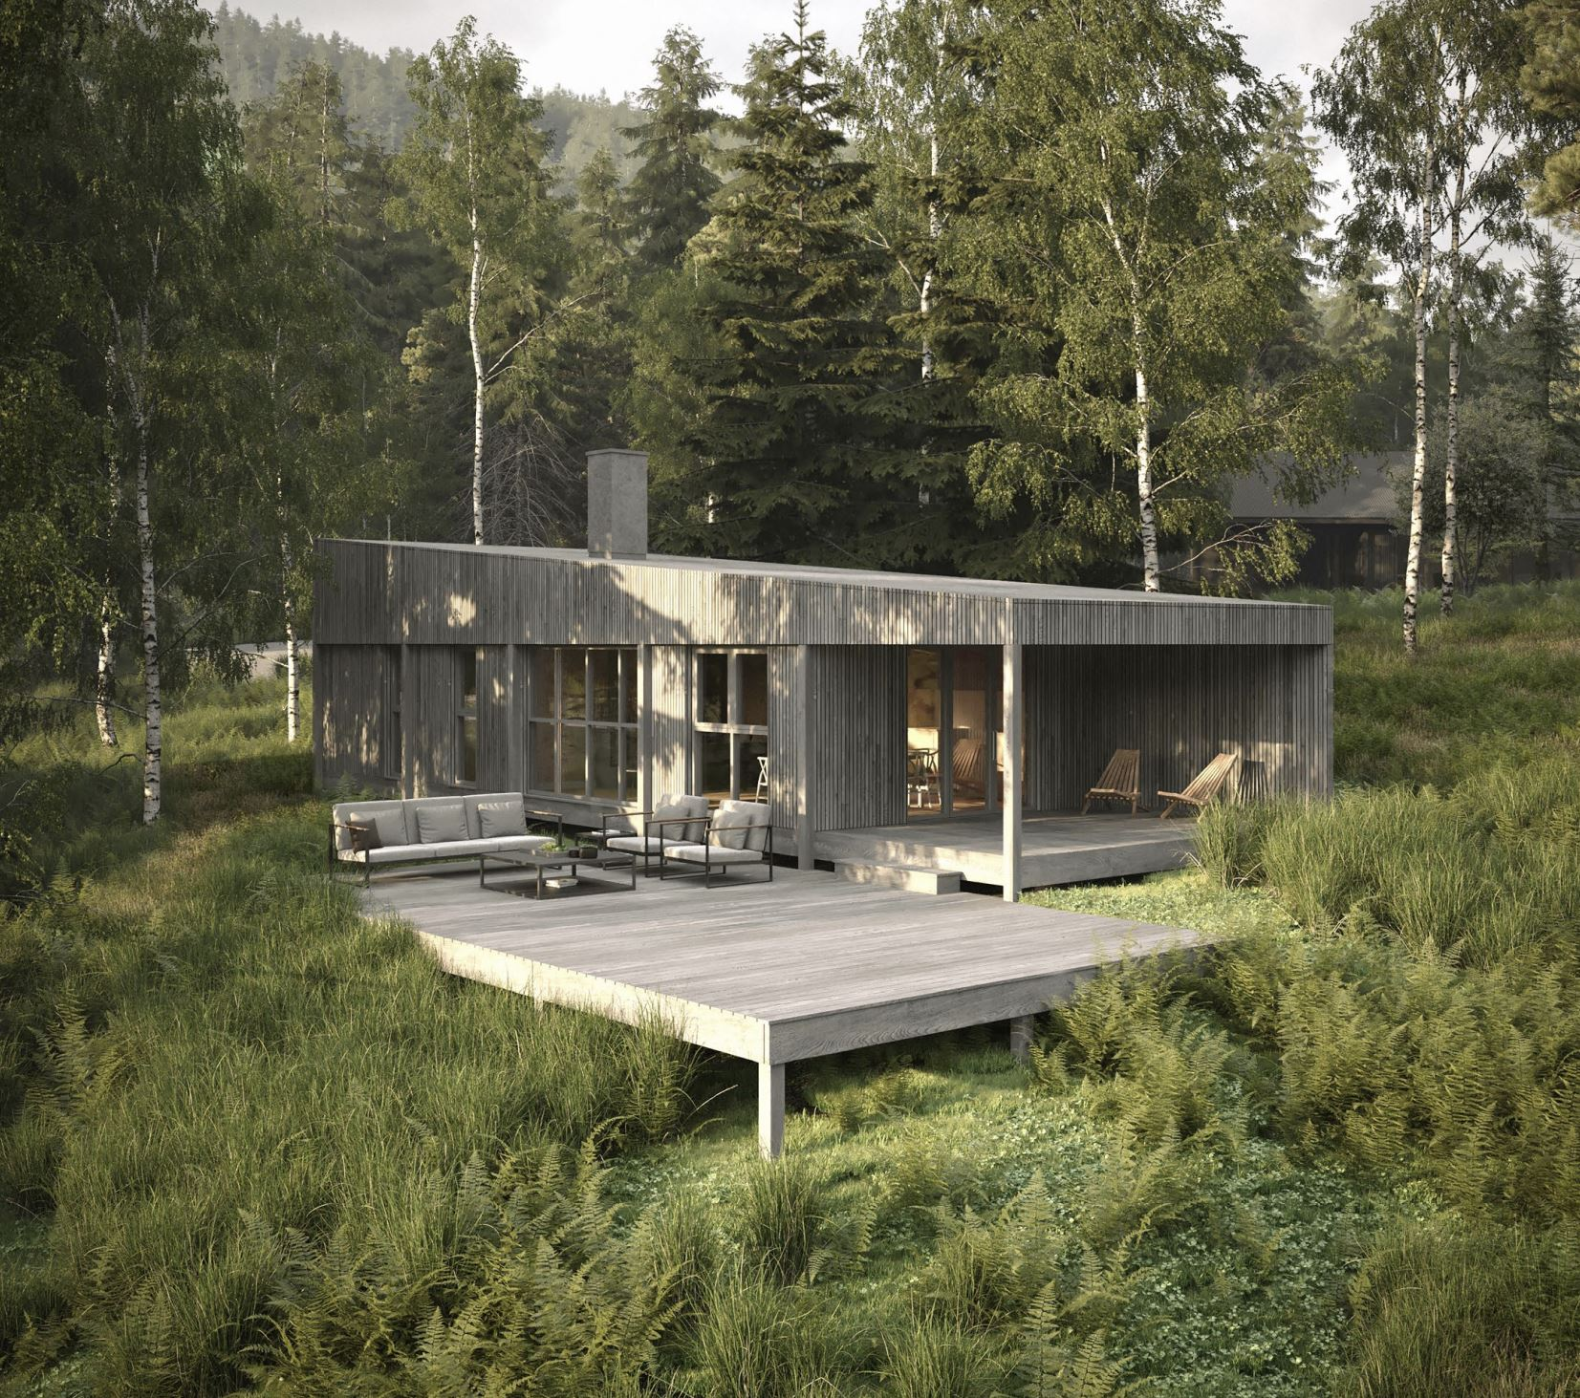
Glen Glack development Dunkeld
Eco, luxury, secluded
1 and 2 bedroom lodges

Slide 8
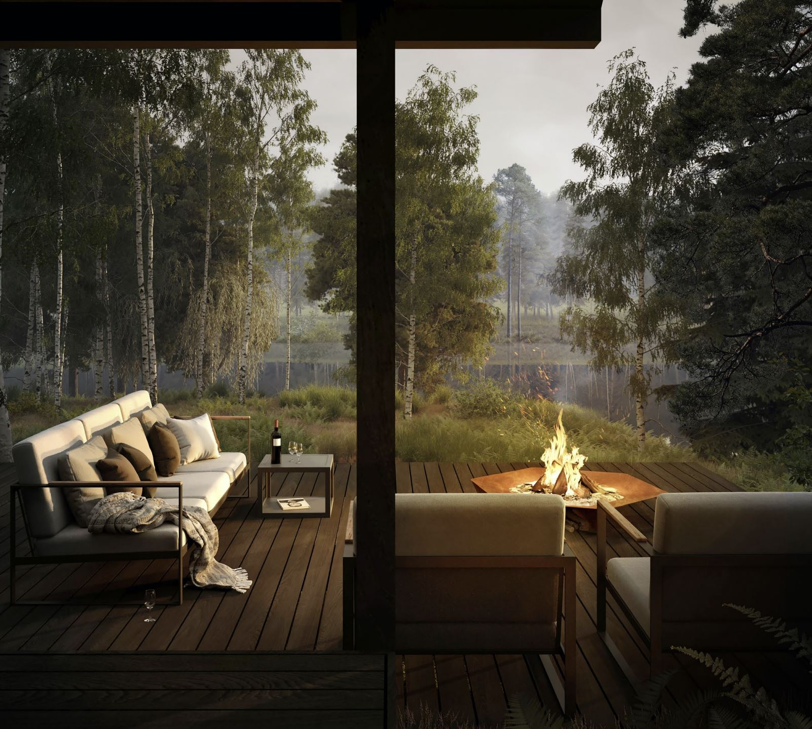
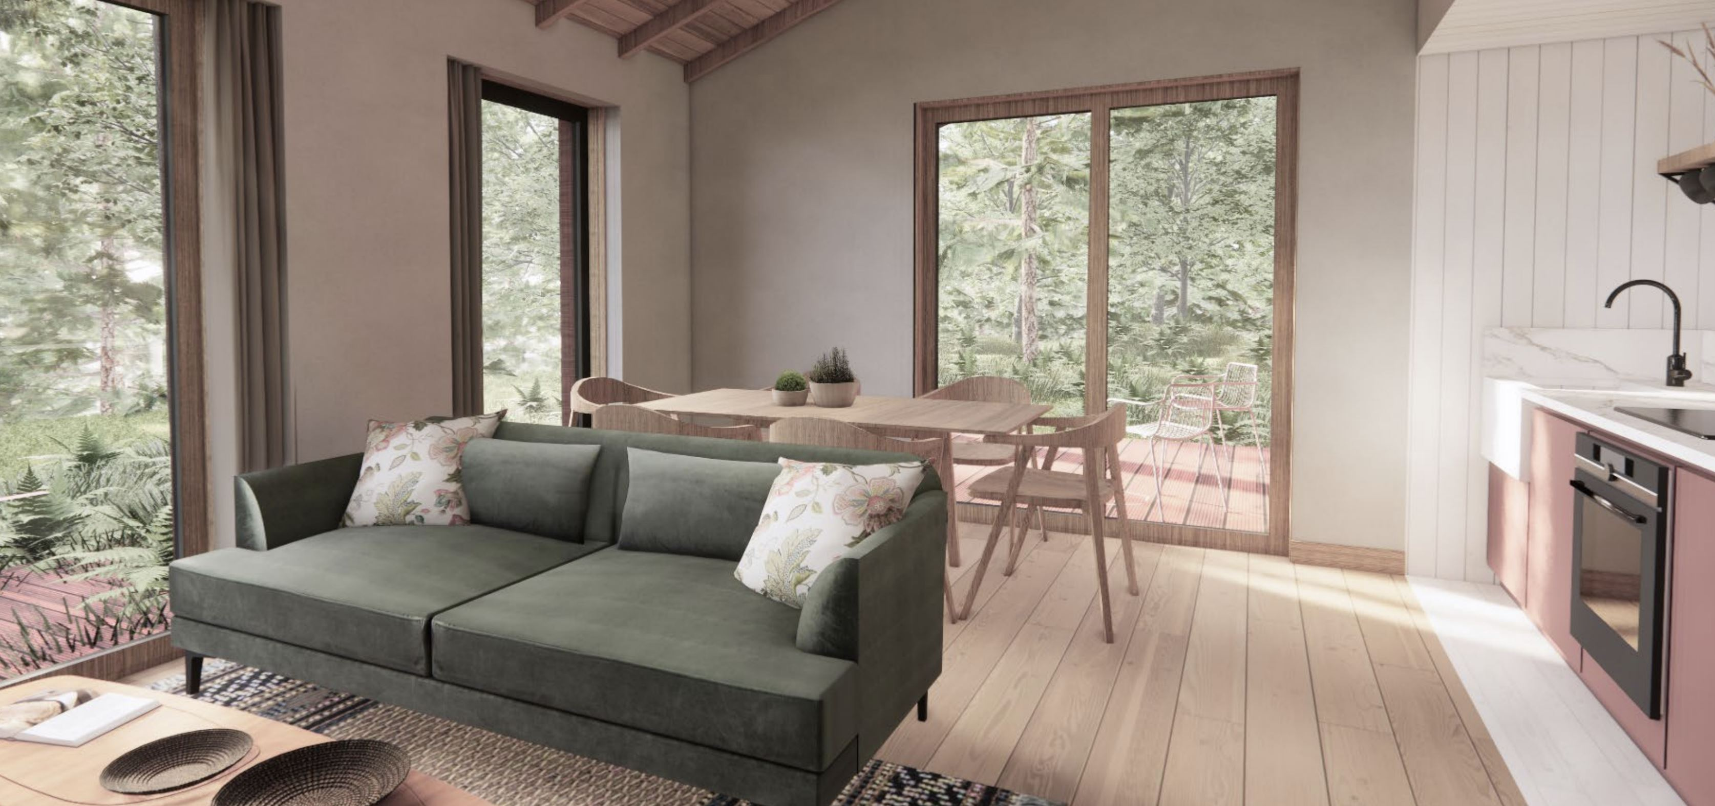
Opens May 2023
Cosy and inviting
Warm and simple

Slide 9
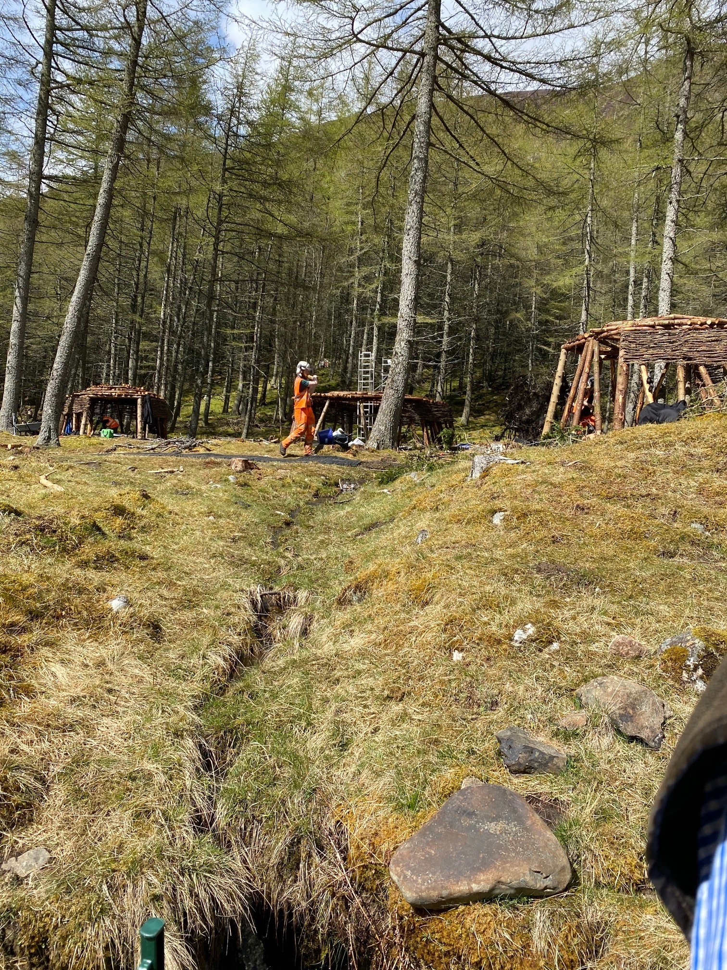
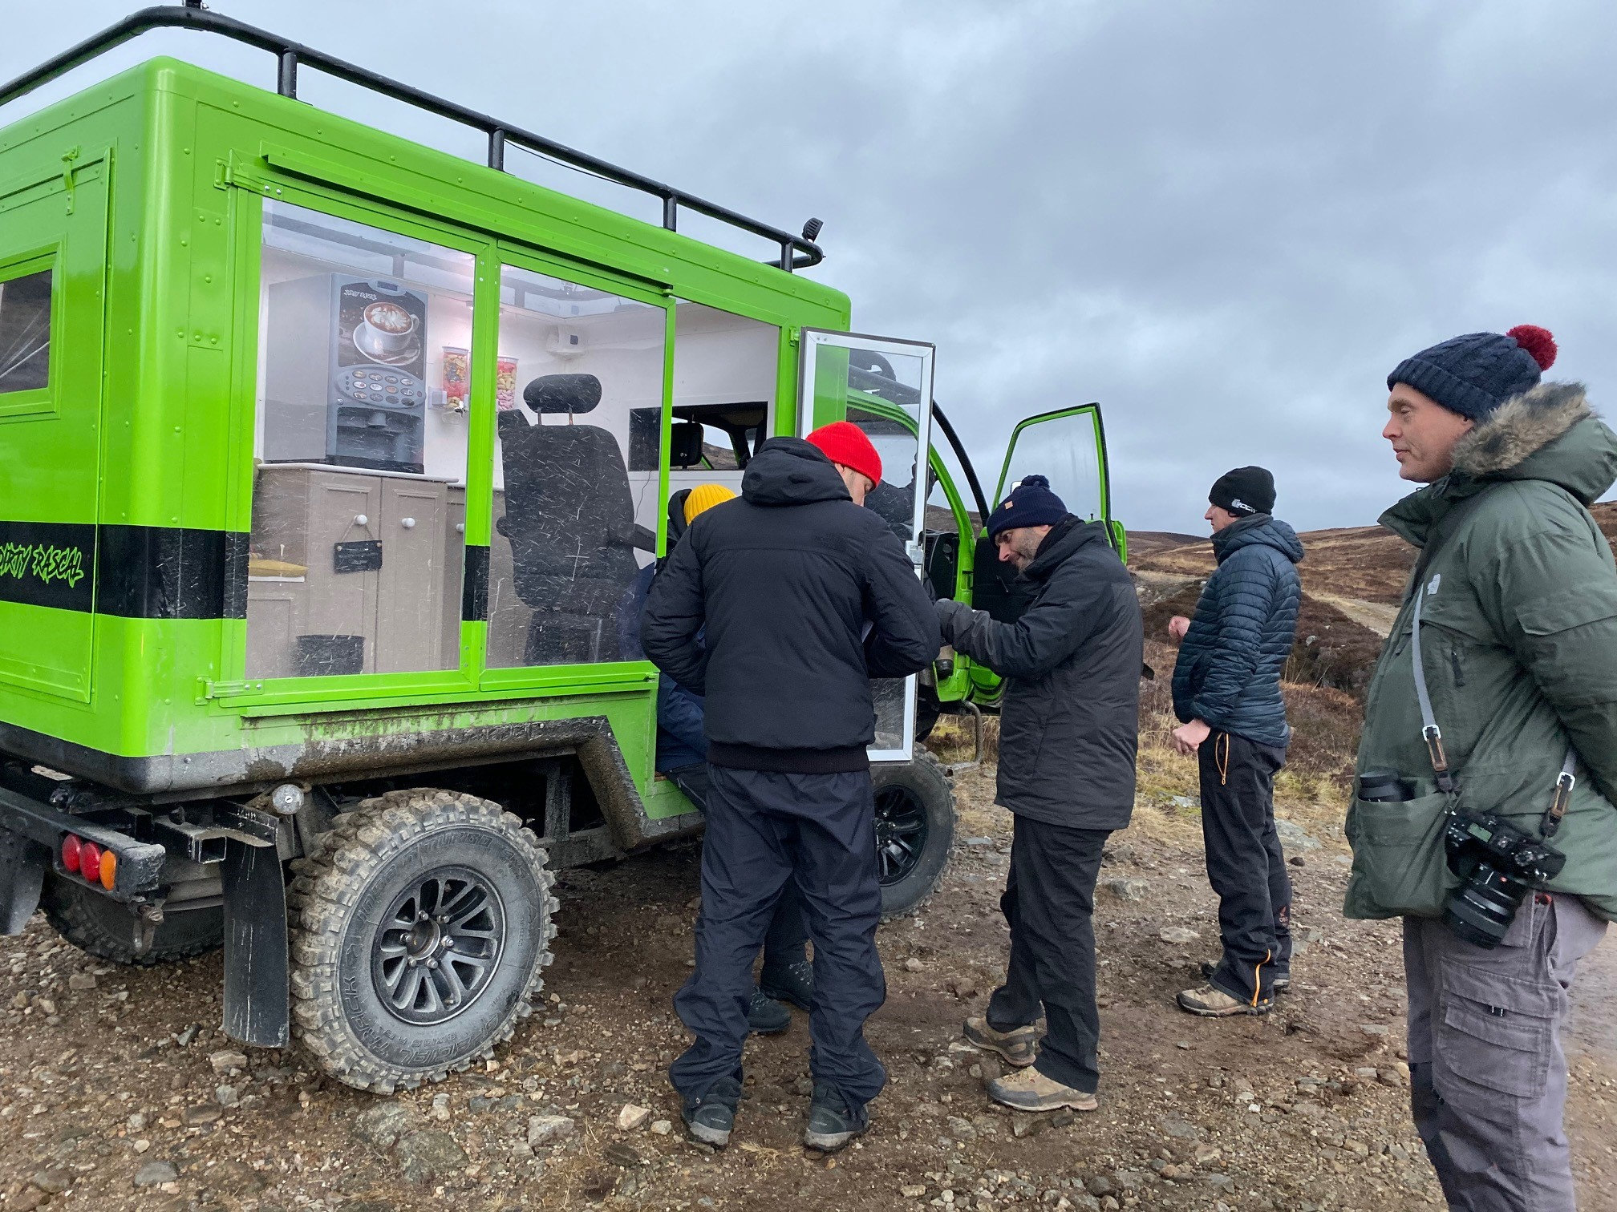
To finish on a fun note!
Star Wars
Top Gear

Slide 10
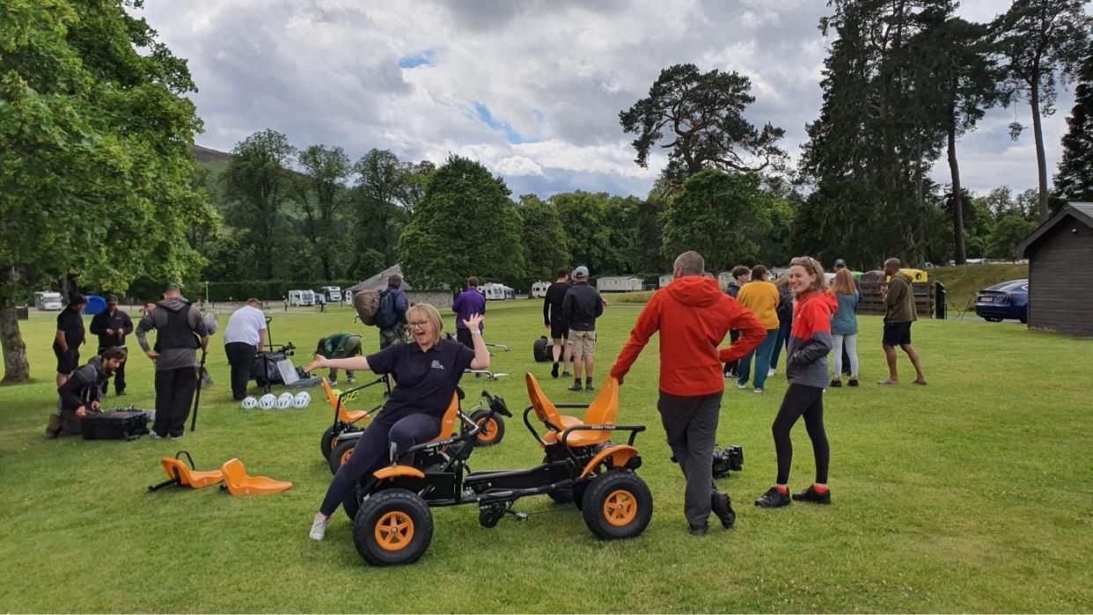
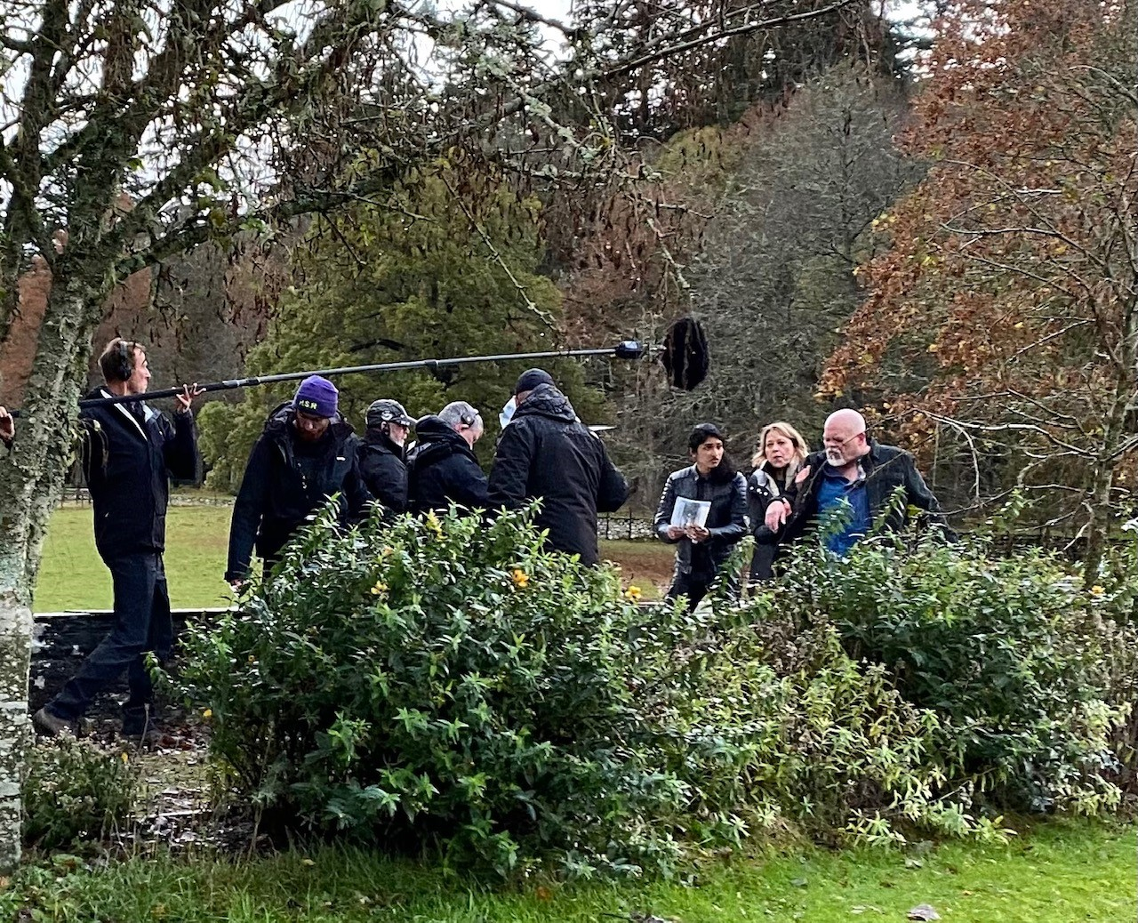
Filming
Perfect Pitch
Annika

Slide 11
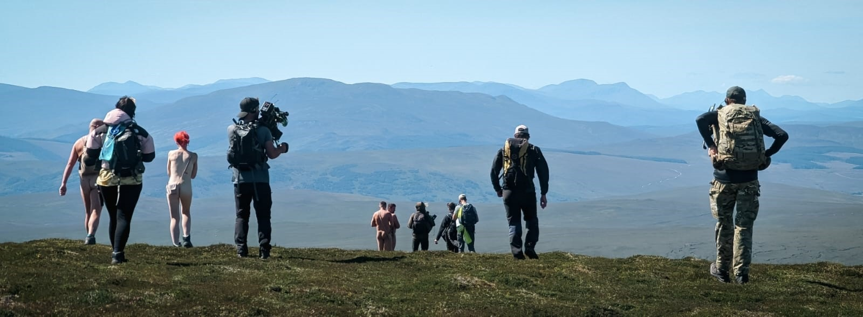
Finally… Naked, alone and trying to get home!

