Slide 1

Future outlook of tourism in perthshire
Chris Greenwood
Moffat Centre for Travel & Tourism business development
17th November 2022

Slide 2
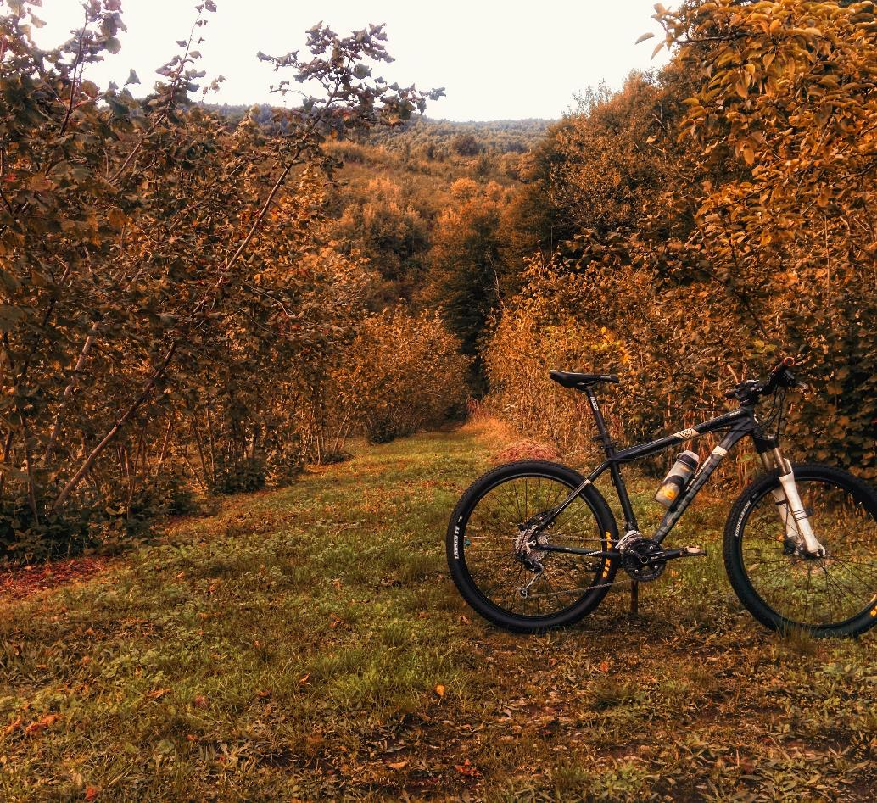
The Moffat center
Created from an endowment from the Moffat Charitable Trust in 1998.
Commercial research and business development agency, based in Glasgow Caledonian University.
Non-Profit making - commercial revenue provides scholarships for GCU tourism students.
Academic contribution as a research centre with peer-reviewed publications and conferences.
Produce and publish the Visitor Attraction Monitor and Scottish Accommodation Occupancy Survey (for VisitScotland).

Slide 3
Where are we now – Global tourism?
Latest UNWTO World Tourism Barometer, global international tourist arrivals almost tripled from January to July 2022 (+172%) compared to the same period in 2021.
This means the sector recovered to 57% of pre-pandemic levels. The steady recovery reflects strong pent-up demand for international travel as well as the easing or lifting of travel restrictions to date (86 countries had no COVID-19-related restrictions as of 19 September 2022).
Europe and the Middle East showed the fastest recovery in January-July 2022, with arrivals reaching 74% and 76% of 2019 levels respectively.
Notes:
The Covid Pandemic of 2020 had a devastating effect on all sectors of the economy including tourism. Understanding the current and future landscape of international and domestic tourism as we recover from COVID-19 and the effects of the cost of living crisis also influences economies, business operating costs and household spending.
Typically we would expect to see a 2.5% to 4% increase in visitor numbers and spending averaged over a year (annual fluctuations will not make this a consistent growth but long-term trends support this assumption). Therefore before 2020, we would expect around a 3% growth trajectory to apply to tourism attractions. The pandemic followed by the squeeze on household income has made estimates more challenging. A broad consensus shows tourism internationally (including Scotland and the UK) to return to pre-pandemic levels by 2024, growing steadily as it has since 2021. We have seen tourism recover up to the start of 2022 through strong domestic visitation and low international inbound (due to restrictions on travel). With the lifting of the travel restrictions, we have seen good visitation from North America and Western European markets to Scotland, albeit slightly below the strongly performing 2019 figures.

Slide 4
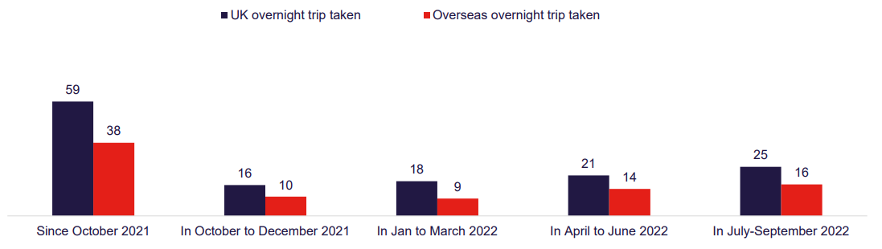
Where are we now - Domestic?
59% of the UK Population has taken a domestic overnight trip since October 2021. 25% taken an overnight trip in the Summer 2022
Trying local food & drink rank top for activities in winter breaks for domestic holidays and second (after walks) in the spring 2023 break
Notes:
The Covid Pandemic of 2020 had a devastating effect on all sectors of the economy including tourism. Understanding the current and future landscape of international and domestic tourism as we recover from COVID-19 and the effects of the cost of living crisis also influences economies, business operating costs and household spending.
Typically we would expect to see a 2.5% to 4% increase in visitor numbers and spending averaged over a year (annual fluctuations will not make this a consistent growth but long-term trends support this assumption). Therefore before 2020, we would expect around a 3% growth trajectory to apply to tourism attractions. The pandemic followed by the squeeze on household income has made estimates more challenging. A broad consensus shows tourism internationally (including Scotland and the UK) to return to pre-pandemic levels by 2024, growing steadily as it has since 2021. We have seen tourism recover up to the start of 2022 through strong domestic visitation and low international inbound (due to restrictions on travel). With the lifting of the travel restrictions, we have seen good visitation from North America and Western European markets to Scotland, albeit slightly below the strongly performing 2019 figures.

Slide 5
Where are we now - International?
1.1m international visitors came to Scotland in H1/2022 (-18% down on H1/2019)
Expenditure by international inbound to Scotland was £1.1 billion in the first half of 2022, +21% up on H1/2019.
North America was a key inbound market with EU15 markets also major contributors.
Notes:
The Covid Pandemic of 2020 had a devastating effect on all sectors of the economy including tourism. Understanding the current and future landscape of international and domestic tourism as we recover from COVID-19 and the effects of the cost of living crisis also influences economies, business operating costs and household spending.
Typically we would expect to see a 2.5% to 4% increase in visitor numbers and spending averaged over a year (annual fluctuations will not make this a consistent growth but long-term trends support this assumption). Therefore before 2020, we would expect around a 3% growth trajectory to apply to tourism attractions. The pandemic followed by the squeeze on household income has made estimates more challenging. A broad consensus shows tourism internationally (including Scotland and the UK) to return to pre-pandemic levels by 2024, growing steadily as it has since 2021. We have seen tourism recover up to the start of 2022 through strong domestic visitation and low international inbound (due to restrictions on travel). With the lifting of the travel restrictions, we have seen good visitation from North America and Western European markets to Scotland, albeit slightly below the strongly performing 2019 figures.

Slide 6
Where are we now - Attractions?
Visitor Attractions in Scotland recorded an annual increase for the month of September 22 of 44%.
Year to September 22 growth against 2021 is 93%.
When compared to 2019 month of September 22 is down -15%.
Visitor Attractions in Perth & Kinross for the Year to September 22 saw a visitor increase of +76.7% vs 2021.
Activity Attractions have grown by +34%.
Museums are up +251% against 2021.
Outdoor attractions continue to be as popular as 2021.
Notes:
The Covid Pandemic of 2020 had a devastating effect on all sectors of the economy including tourism. Understanding the current and future landscape of international and domestic tourism as we recover from COVID-19 and the effects of the cost of living crisis also influences economies, business operating costs and household spending.
Typically we would expect to see a 2.5% to 4% increase in visitor numbers and spending averaged over a year (annual fluctuations will not make this a consistent growth but long-term trends support this assumption). Therefore before 2020, we would expect around a 3% growth trajectory to apply to tourism attractions. The pandemic followed by the squeeze on household income has made estimates more challenging. A broad consensus shows tourism internationally (including Scotland and the UK) to return to pre-pandemic levels by 2024, growing steadily as it has since 2021. We have seen tourism recover up to the start of 2022 through strong domestic visitation and low international inbound (due to restrictions on travel). With the lifting of the travel restrictions, we have seen good visitation from North America and Western European markets to Scotland, albeit slightly below the strongly performing 2019 figures.

Slide 7
Where are we now – Occupancy in Perthshire
Occupancy Rates across Serviced and Non-Serviced exceeded 2019 levels from early summer
If you are an accommodation business and wish to participate in the Occupancy Survey contact info@moffatcentre.com
Source: VisitScotland Scottish Accommodation Occupancy Survey
Notes:
The Covid Pandemic of 2020 had a devastating effect on all sectors of the economy including tourism. Understanding the current and future landscape of international and domestic tourism as we recover from COVID-19 and the effects of the cost of living crisis also influences economies, business operating costs and household spending.
Typically we would expect to see a 2.5% to 4% increase in visitor numbers and spending averaged over a year (annual fluctuations will not make this a consistent growth but long-term trends support this assumption). Therefore before 2020, we would expect around a 3% growth trajectory to apply to tourism attractions. The pandemic followed by the squeeze on household income has made estimates more challenging. A broad consensus shows tourism internationally (including Scotland and the UK) to return to pre-pandemic levels by 2024, growing steadily as it has since 2021. We have seen tourism recover up to the start of 2022 through strong domestic visitation and low international inbound (due to restrictions on travel). With the lifting of the travel restrictions, we have seen good visitation from North America and Western European markets to Scotland, albeit slightly below the strongly performing 2019 figures.

Slide 8
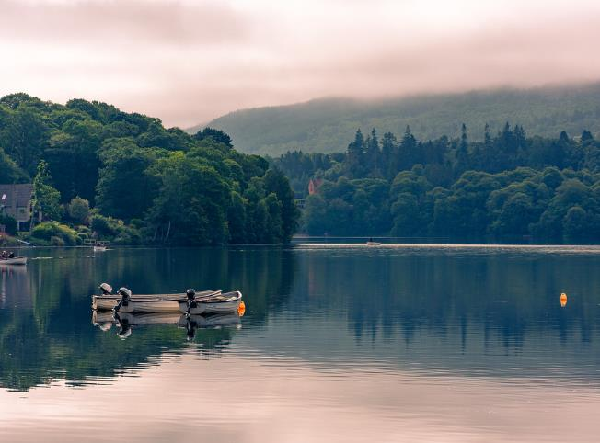
A Look ahead
As the post-pandemic recovery stalled in 2022 and became the cost of living crisis consumers and businesses have been challenged by rising inflation, interest rates, and input costs that will have implications for 2023 and beyond

Slide 9
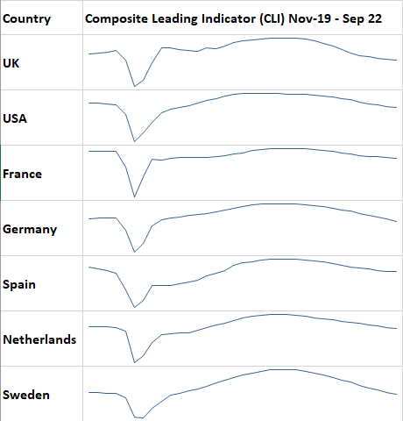
Economic Outlook
Price Waterhouse Cooper forecasts UK economic growth in 2023 of between -1.3% and 0.2% dependent on a harsh or mild winter scenario, followed by two years of slow or negative economic growth.
UK inflation outlook is highly uncertain. PWC scenario analysis suggests inflation could peak at 17% in the first half of 2023.
Government intervention on household energy bills could see inflation peak at between 10% to 13%.
Source: OECD
Notes:
The Covid Pandemic of 2020 had a devastating effect on all sectors of the economy including tourism. Understanding the current and future landscape of international and domestic tourism as we recover from COVID-19 and the effects of the cost of living crisis also influences economies, business operating costs and household spending.
Typically we would expect to see a 2.5% to 4% increase in visitor numbers and spending averaged over a year (annual fluctuations will not make this a consistent growth but long-term trends support this assumption). Therefore before 2020, we would expect around a 3% growth trajectory to apply to tourism attractions. The pandemic followed by the squeeze on household income has made estimates more challenging. A broad consensus shows tourism internationally (including Scotland and the UK) to return to pre-pandemic levels by 2024, growing steadily as it has since 2021. We have seen tourism recover up to the start of 2022 through strong domestic visitation and low international inbound (due to restrictions on travel). With the lifting of the travel restrictions, we have seen good visitation from North America and Western European markets to Scotland, albeit slightly below the strongly performing 2019 figures.

Slide 10
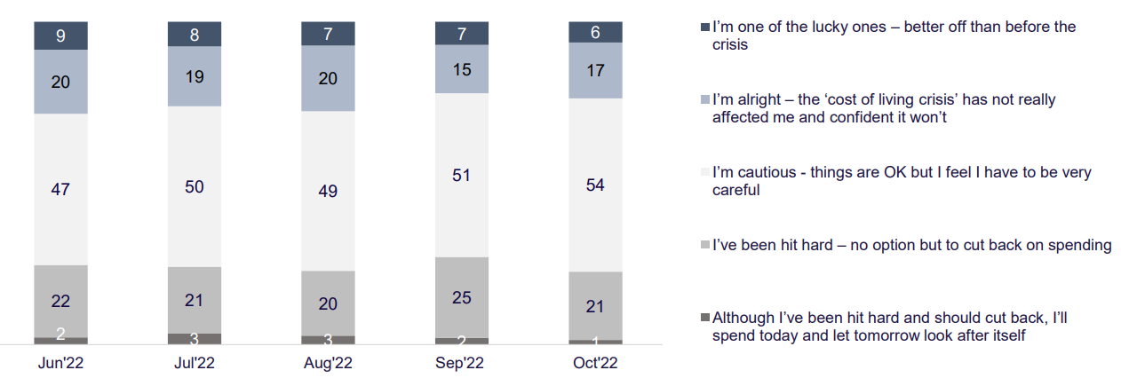
Consumer sentiment
The majority of UK adults are either ‘cautious – being very careful’ or they have already been ‘hit hard’ by the cost of living crisis. And the proportion of those affected is growing.
Source: GB National Tourist Boards Domestic Sentiment Tracker Oct 2022
Notes:
The Covid Pandemic of 2020 had a devastating effect on all sectors of the economy including tourism. Understanding the current and future landscape of international and domestic tourism as we recover from COVID-19 and the effects of the cost of living crisis also influences economies, business operating costs and household spending.
Typically we would expect to see a 2.5% to 4% increase in visitor numbers and spending averaged over a year (annual fluctuations will not make this a consistent growth but long-term trends support this assumption). Therefore before 2020, we would expect around a 3% growth trajectory to apply to tourism attractions. The pandemic followed by the squeeze on household income has made estimates more challenging. A broad consensus shows tourism internationally (including Scotland and the UK) to return to pre-pandemic levels by 2024, growing steadily as it has since 2021. We have seen tourism recover up to the start of 2022 through strong domestic visitation and low international inbound (due to restrictions on travel). With the lifting of the travel restrictions, we have seen good visitation from North America and Western European markets to Scotland, albeit slightly below the strongly performing 2019 figures.

Slide 11
Accommodation occupancy forecasts
PWC forecast that RevPAR (revenue per available room) in UK regions (Outside London) in 2023 to be between £49.50 (-9.4% YoY) and £54.70 (-0.6% YoY) in real terms (adjusting for inflation).
PWC Annual Occupancy Forecasts for 2023 vary from 70.6% (-5,9% YoY) to 77.1% (+2.1% YoY) on a worse to the best-case scenario.
It was noted that for Scotland the major events of the UCI Cycling Championships will boost occupancy in Glasgow, Edinburgh and the central belt.
Notes:
The Covid Pandemic of 2020 had a devastating effect on all sectors of the economy including tourism. Understanding the current and future landscape of international and domestic tourism as we recover from COVID-19 and the effects of the cost of living crisis also influences economies, business operating costs and household spending.
Typically we would expect to see a 2.5% to 4% increase in visitor numbers and spending averaged over a year (annual fluctuations will not make this a consistent growth but long-term trends support this assumption). Therefore before 2020, we would expect around a 3% growth trajectory to apply to tourism attractions. The pandemic followed by the squeeze on household income has made estimates more challenging. A broad consensus shows tourism internationally (including Scotland and the UK) to return to pre-pandemic levels by 2024, growing steadily as it has since 2021. We have seen tourism recover up to the start of 2022 through strong domestic visitation and low international inbound (due to restrictions on travel). With the lifting of the travel restrictions, we have seen good visitation from North America and Western European markets to Scotland, albeit slightly below the strongly performing 2019 figures.

Slide 12
Outlook for 2023 - Forecast?
Intentions for domestic and overseas trips in October to December 2022 period for UK residents 21% intend to take a domestic trip and 16% intend to take an overseas trip in Q1/2023.
68% of UK adults plan on taking an overnight domestic trip at some point in the next 12 months.
The ‘rising cost of living is the biggest perceived barrier to taking overnight UK trips in the next 6 months (45% stating this), followed by ‘personal finances’ (31%) and ‘rising costs of holidays/leisure’ (30%).
Notes:
The Covid Pandemic of 2020 had a devastating effect on all sectors of the economy including tourism. Understanding the current and future landscape of international and domestic tourism as we recover from COVID-19 and the effects of the cost of living crisis also influences economies, business operating costs and household spending.
Typically we would expect to see a 2.5% to 4% increase in visitor numbers and spending averaged over a year (annual fluctuations will not make this a consistent growth but long-term trends support this assumption). Therefore before 2020, we would expect around a 3% growth trajectory to apply to tourism attractions. The pandemic followed by the squeeze on household income has made estimates more challenging. A broad consensus shows tourism internationally (including Scotland and the UK) to return to pre-pandemic levels by 2024, growing steadily as it has since 2021. We have seen tourism recover up to the start of 2022 through strong domestic visitation and low international inbound (due to restrictions on travel). With the lifting of the travel restrictions, we have seen good visitation from North America and Western European markets to Scotland, albeit slightly below the strongly performing 2019 figures.

Slide 13
Outlook for 2023 - Intent?
‘cost of accommodation’ is the top barrier to taking overnight UK trips in the next 6 months (47%), followed closely by the ‘cost of fuel’ (46%).
Only 21% cited the cost of visitor attractions as a barrier to taking a UK or short break in the next 6 months.
Scotland remains a popular destination, being the second most popular choice (after North West England) for a domestic trip in the next six months.
Trying local food and drink, visiting cultural attractions and walking/hiking represent the top three intended activities to undertake on domestic trips in the next three and six months.
Notes:
The Covid Pandemic of 2020 had a devastating effect on all sectors of the economy including tourism. Understanding the current and future landscape of international and domestic tourism as we recover from COVID-19 and the effects of the cost of living crisis also influences economies, business operating costs and household spending.
Typically we would expect to see a 2.5% to 4% increase in visitor numbers and spending averaged over a year (annual fluctuations will not make this a consistent growth but long-term trends support this assumption). Therefore before 2020, we would expect around a 3% growth trajectory to apply to tourism attractions. The pandemic followed by the squeeze on household income has made estimates more challenging. A broad consensus shows tourism internationally (including Scotland and the UK) to return to pre-pandemic levels by 2024, growing steadily as it has since 2021. We have seen tourism recover up to the start of 2022 through strong domestic visitation and low international inbound (due to restrictions on travel). With the lifting of the travel restrictions, we have seen good visitation from North America and Western European markets to Scotland, albeit slightly below the strongly performing 2019 figures.

Slide 14
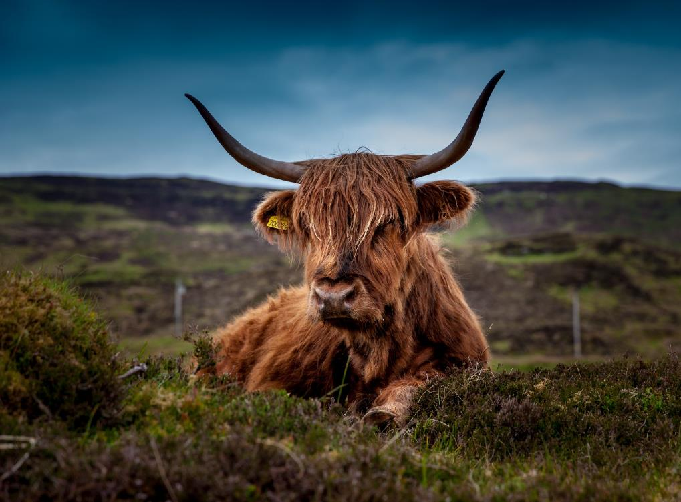
Trends for a Sustainable Future
Consumer concern over the environment and climate has doubled in the last decade. In fact, global trends (Ipsos) find that “Climate Emergency” is one of the common values that unite us worldwide.
But as the financial crisis bites, will the environment takes a back seat?

Slide 15
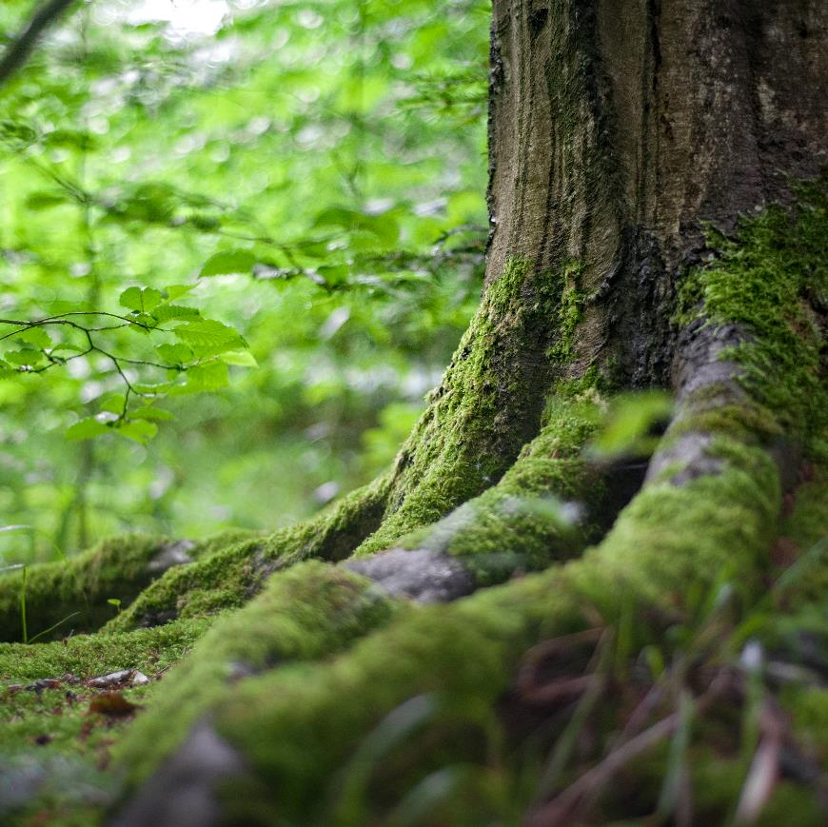
Intentions In a Disruptive World
Consumers’ concern about climate issues is high, but what we say and what we do varies considerably…
65% of consumers say they want to buy sustainably, and only 26% do. (HBR, 2019)
Disruption leads to displacement… People want businesses to take the initiative.

Slide 16
Consumers Are Looking for Sustainable Travel Options and Turning to Trusted Resources for Guidance
Nine in 10 consumers said they look for sustainable options when travelling.
But 70% reported feeling overwhelmed by starting the process of being a more sustainable traveller.
Trusted travel resources provide inspiration and guidance to inform decisions, including destinations, accommodation, transport, and booking sites.
Most consumers said it costs more to be sustainable, but half would be willing to pay more
Source: Wakefield Research, 11,000 representative consumers in 11 countries: Australia, Brazil, Canada, China, France, Germany, India, Japan, Mexico, the UK, and the U.S.

Slide 17
Opportunities in sustainable travel
Consumer interest in sustainable travel continues to grow.
Business recommendations have a high value.
Be authentic, 7 in 10 consumers avoid a destination because they felt it wasn’t truly committed to sustainable practices.
Source: Wakefield Research, 11,000 representative consumers in 11 countries: Australia, Brazil, Canada, China, France, Germany, India, Japan, Mexico, the UK, and the U.S.

Slide 18
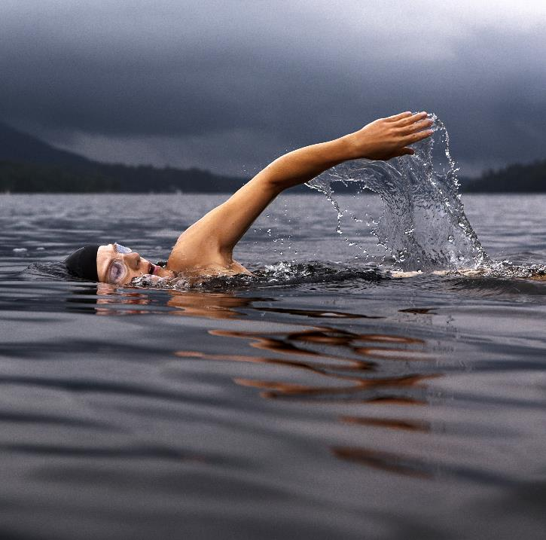



Trends shaping responsible travel into 2023
Sustainable Businesses will win
Personal impact is a consideration when booking
78 per cent of global travellers revealed that they intend to look for low-impact properties to stay in.
This could include locations that feature rainwater harvesting, ground pump heating systems or were built using sustainable materials.
Demonstrating your green credentials as part of your brand values and marketing
71 per cent of travellers say they will make a concerted effort to put sustainability at the forefront of their next holiday choice.
More than half (59 percent) of people claim they want to leave a destination better than when they arrived.
Promote activities or tours that would positively impact local spaces. Promote Local to Buy Local

Slide 19


Trends shaping responsible travel into 2023
50 per cent of travellers admit that readily available information about climate change has made them rethink when they take a holiday.
An emerging trend is exploring during off-peak seasons, to avoid overcrowding and lessen the impact on host destinations.
Provide itineraries and lists of activity providers, accommodation, hospitality and attractions that are open at various times of the year to show what a visitor can do throughout the seasons.
Sustainable luxury will become an important niche
27 per cent of travellers assume that sustainable destinations won’t be as luxurious as they want.
Five-star luxury sustainable accommodation is likely to become a trend.
Social media opportunities to promote your sustainability credentials and quality product to dispel myths.
Think of the role of user-generated feedback to promote advocates and word of mouth.
Off-peak will become the new peak

Slide 20
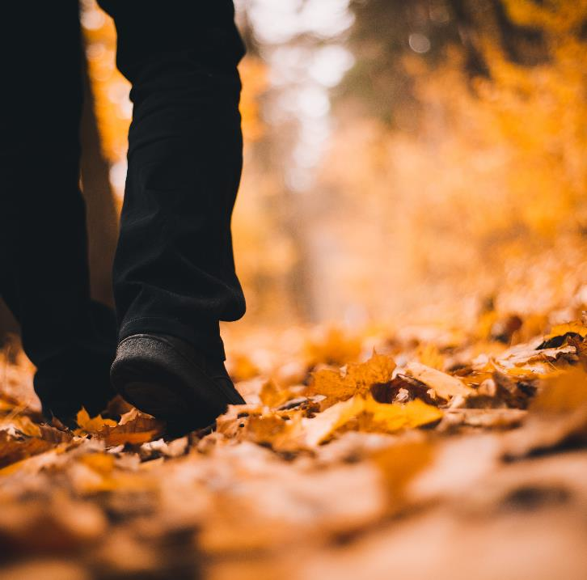


Trends shaping responsible travel into 2023
Cultural immersion will be the standard for Leisure
Responsibility and relaxation will go side-by-side
45 per cent of travellers say they see learning about local cultures as key to sustainable travel.
66 per cent of people want to have ‘authentic’ experiences that give insight into local culture way from exaggerated tourist attractions.
Local recommendations, hidden gems, myths, stories, legends and people engage and delight visitors.
Getting away from it will no longer mean shirking all responsibility.
29 per cent of travellers feel they have a responsibility to reduce the negative effects of tourism.
Promote conscious exploration by the provision of waste management strategies, and distribution of visitor flows to reduce overcrowding and instill and community lead appreciation of the natural and built environment
Sourced in part and inspired by Booking.com Sustainable Travel Report 2022

Slide 21
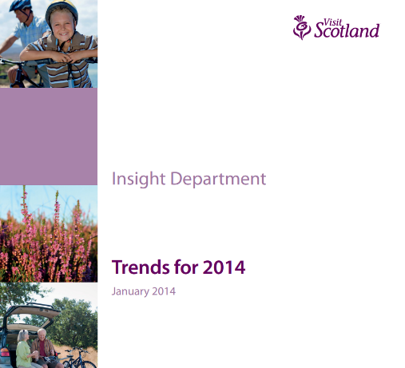
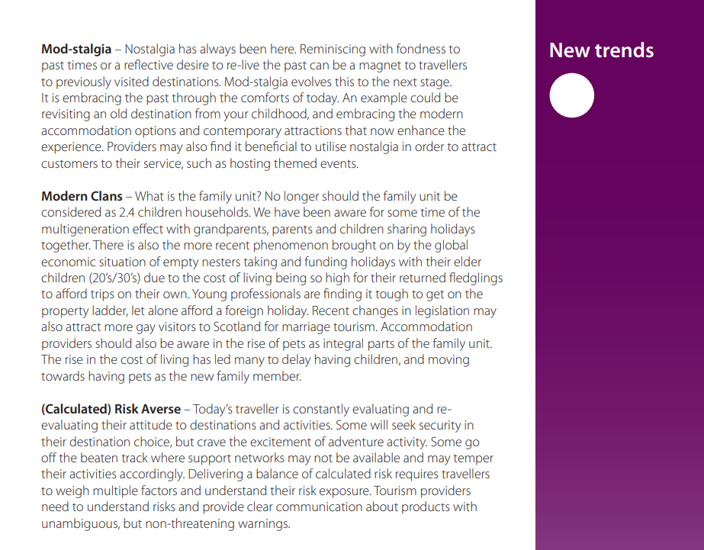


Oh, one last thing…..
Notes:
The Covid Pandemic of 2020 had a devastating effect on all sectors of the economy including tourism. Understanding the current and future landscape of international and domestic tourism as we recover from COVID-19 and the effects of the cost of living crisis also influences economies, business operating costs and household spending.
Typically we would expect to see a 2.5% to 4% increase in visitor numbers and spending averaged over a year (annual fluctuations will not make this a consistent growth but long-term trends support this assumption). Therefore before 2020, we would expect around a 3% growth trajectory to apply to tourism attractions. The pandemic followed by the squeeze on household income has made estimates more challenging. A broad consensus shows tourism internationally (including Scotland and the UK) to return to pre-pandemic levels by 2024, growing steadily as it has since 2021. We have seen tourism recover up to the start of 2022 through strong domestic visitation and low international inbound (due to restrictions on travel). With the lifting of the travel restrictions, we have seen good visitation from North America and Western European markets to Scotland, albeit slightly below the strongly performing 2019 figures.

Slide 22

Thank you!
info@moffatcentre.com
http://www.moffatcentre.com/

