Slide 1
PERTH CITY & TOWNS
SUPPORTING YOUR TOURISM BUSINESS

Slide 2


Our Channels
Perthcity.co.uk website
An average of 20K page views per month rising to 40K over key periods
Facebook @perthcityandtowns 28K Followers
Twitter @perthcitycentre 11.5K Followers
Mailchimp
15K recipients
Instagram
6.5K Followers @perthcityandtowns
YouTube
Recently relaunched. 246K Minutes watched in March and April.

Slide 3




























Ongoing Marketing Opportunities
Join the Business Directory
Create a login, a listing and take full control of your entry, updating any time you wish.
Already Listed? Check and update for summer 2022 promotion including window vinyls and social campaigns
Online Gift Guide
The year-round Gift Guide is a popular page on the website and used by our Comms Contractor for promotion during Key retail periods. If you'd like to be featured, please contact Katie Young at The Red String Agency: katie@theredstringagency.co.uk
WHERE
CHRISTMAS
IS
MADE
List your Event
Simply create your Facebook event, add Perth City & Towns as a co-host and it will appear on our Facebook page and in our website event section. We may also list it in our newsletters to our 15,000 strong list.
Keep Up To Date
Join the mailing list for the Business-To- Business newsletter from Emily Queen. Please email: katie@theredstringagency.co.uk
FREE CHRISTMAS
GIFT
GUIDE
Featuring over 100 gift ideas from the fantastic independent shops of Perth, City and Towns

Slide 4
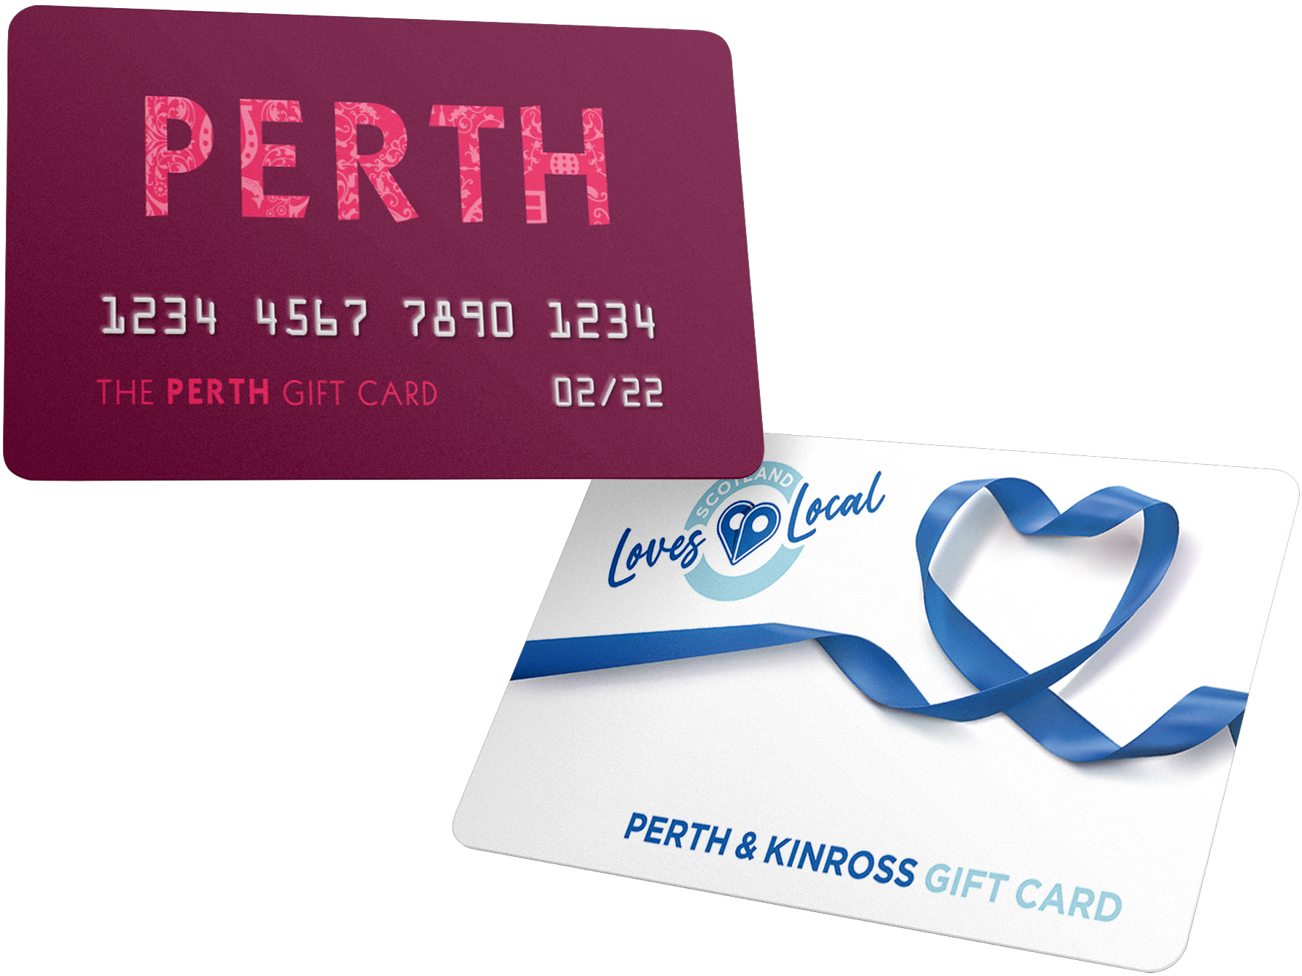
The Perth Gift Card
‘Scotland Loves Local’ for Perth & Kinross
Businesses across the region can now accept the Scotland Loves Local Perth & Kinross Card and The Perth Gift Card.
Free to accept
Simple to join
No fee outwith your own merchant costs
Redeemed via the MasterCard network
Register at: lovelocal.scot/register-your-business/

Slide 5

Think Big Perthshire Campaign
March & April 2022
£70K grant funding from Visit Scotland
Focused on 25 – 45 age group
Outdoor enthusiasts looking for experiences
Hero Video and 5 additional social videos
Landing Page with links out to key topics
Building an image library
Radio advertising Campaign and Presenter Talk Ups across Scotland
Coverage in Cosmopolitan, Men’s Health, The Skinny

Slide 6
Sample Campaign Imagery

Slide 7
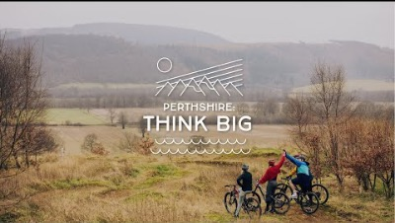

Slide 8

Think Big Perthshire Campaign
KEY STATS
Competition Page Views 8,307
YouTube Video Views / Minutes Watched
127,000 / 246,000
All other Social Media Reach
1.2 Million
Competition Entries 8,937
Website Page Views 56,359
Additional data for mailing list 1,124
Competitions in Cosmopolitan, Men’s Health, The Skinny, Bauer radio
Editorial and Advertorial across national titles

Slide 9
Be Inspired Perthshire Campaign
SUMMER 2022
Article and Web Content Building
Listicle articles / Landing Pages hosted on Perth City website
Shared via digital channels across the region
Aim to feature a minimum of 150 businesses, attractions and events
5 Days of Photography
Aim to feature 20 - 25 businesses, attractions and events and the people who make them
Podcast Production
A summer podcast series
Hosted on Perth City and third party sites
Media & Influencers
Influencers
Paid Partnerships with national media (native content / advertorial)
Ad Campaign
Radio
Press
Competition Prizes
Prizes purchased
Paid partnerships

Slide 10
Be Inspired Perthshire Campaign
SUMMER 2022
Cycling
Events and Festivals
Jubilee Weekend
Pet Friendly Accommodation
Historical Attractions & Visitor Tours
Wheelchair Friendly Perthshire
Soup and a Sarnie Spots
Campsites and Caravans
Distilleries
School Holiday Fun
Gourmet Accommodation
Cocktails and Artisan Drinks
Meet The Animals - Family focused
Learn To.... Schools and Courses

Slide 11
Be Inspired Perthshire Campaign
SUMMER 2022
GET INVOLVED:
Register on our business directory now: Contact katie@theredstringagency.co.uk

